Slide 1
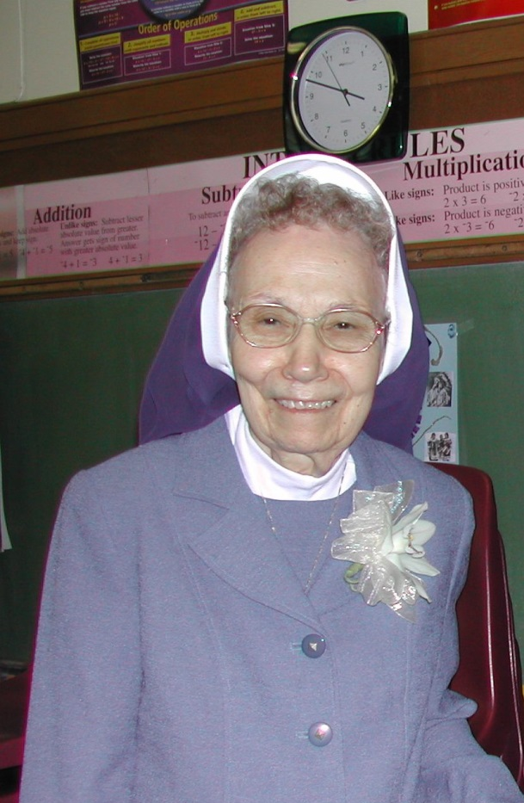
Born ~ Dorothy Ruth
January 31, 1927
Entrance ~
December 7, 1944
Perpetual Vows ~
August 12, 1950
Golden Jubilee ~
May 1994
Diamond [70th] Jubilee ~
August 2014
Sister John Francis Danko, CDP

Slide 2
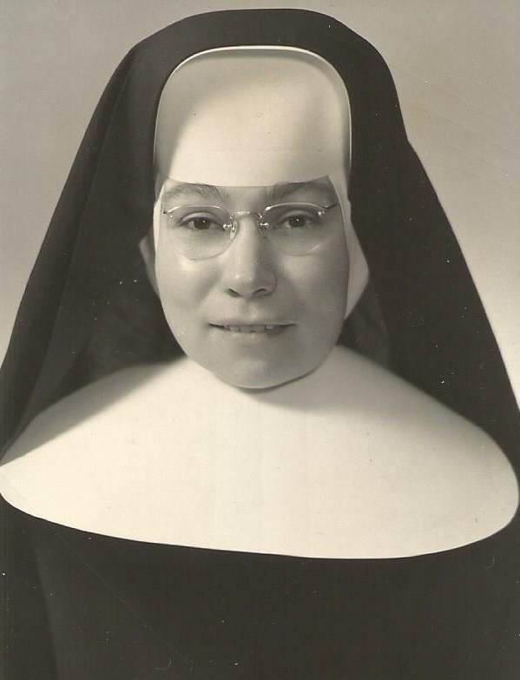
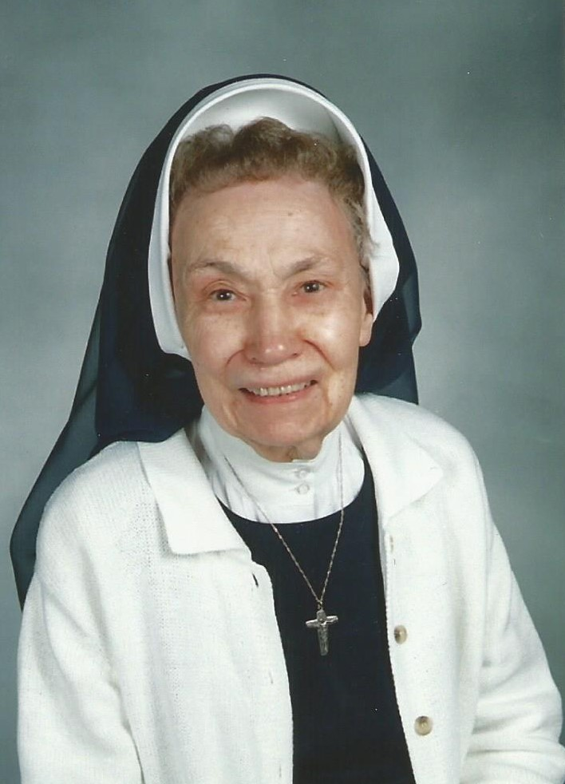

Slide 3
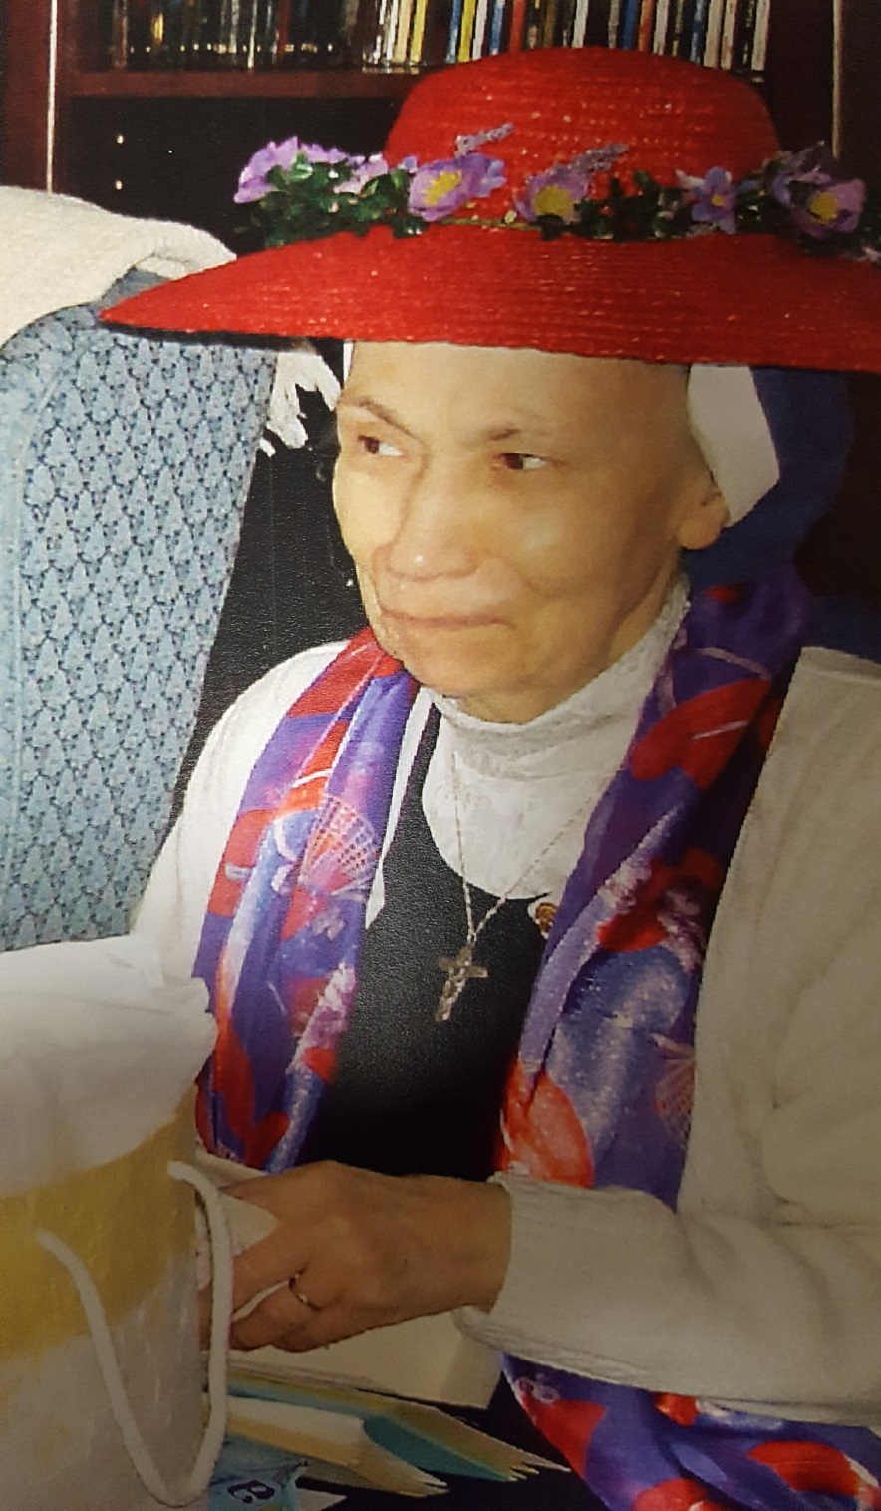
Community
Celebrations

Slide 4
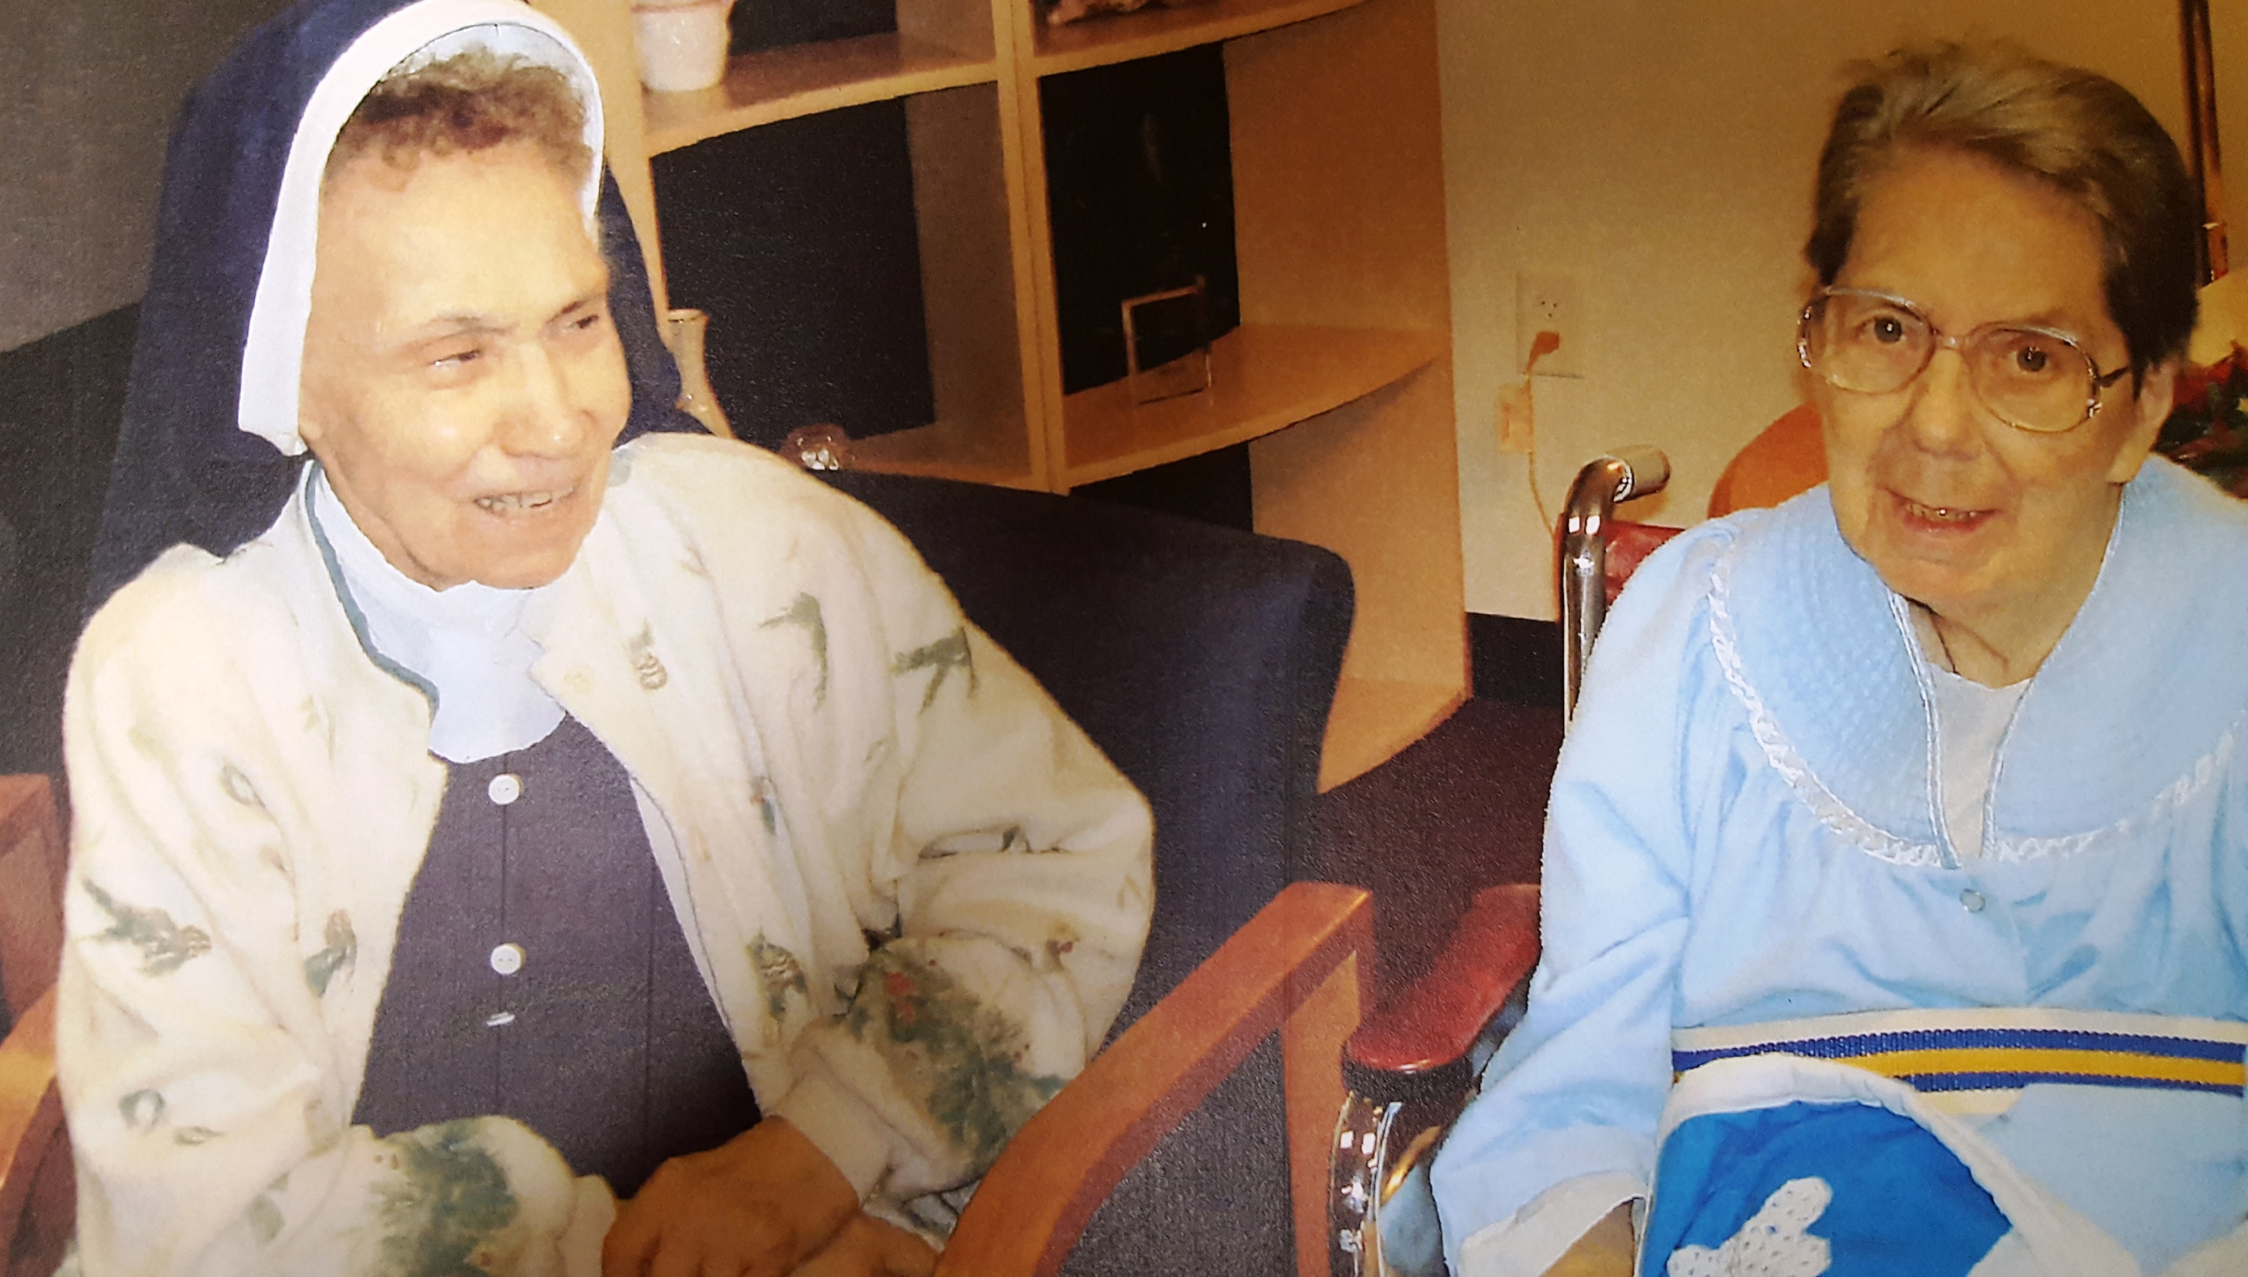
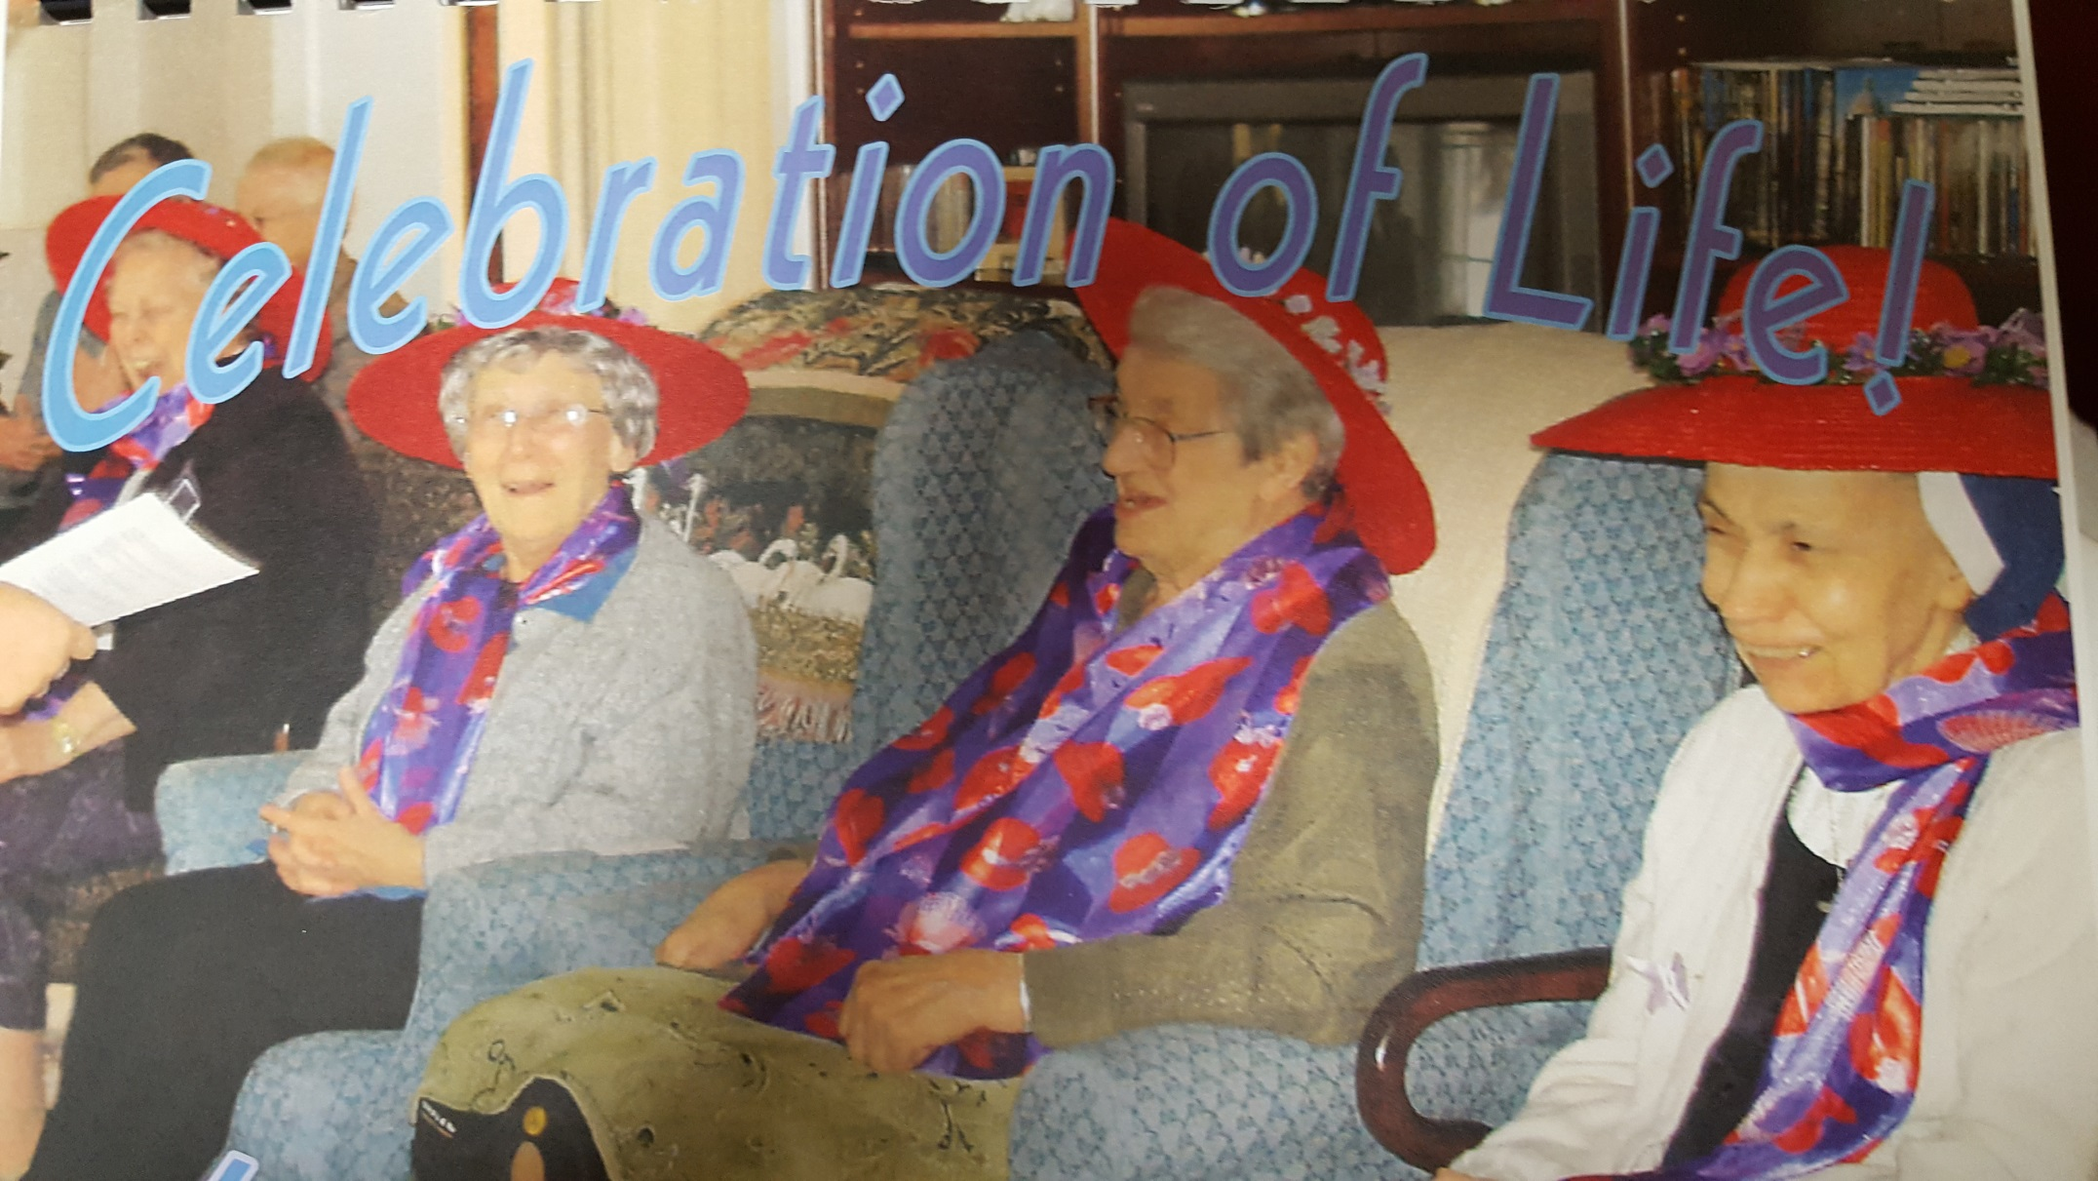

Slide 5
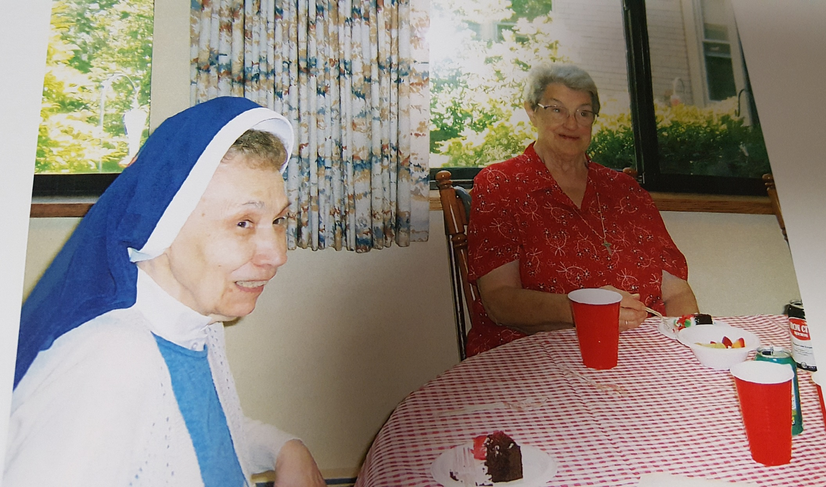

Slide 7
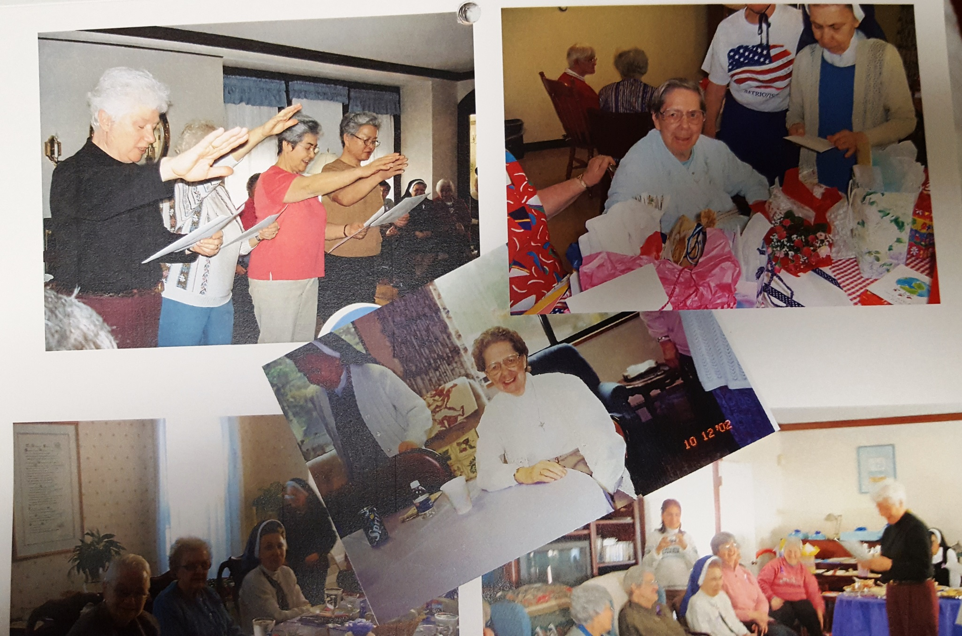

Slide 8
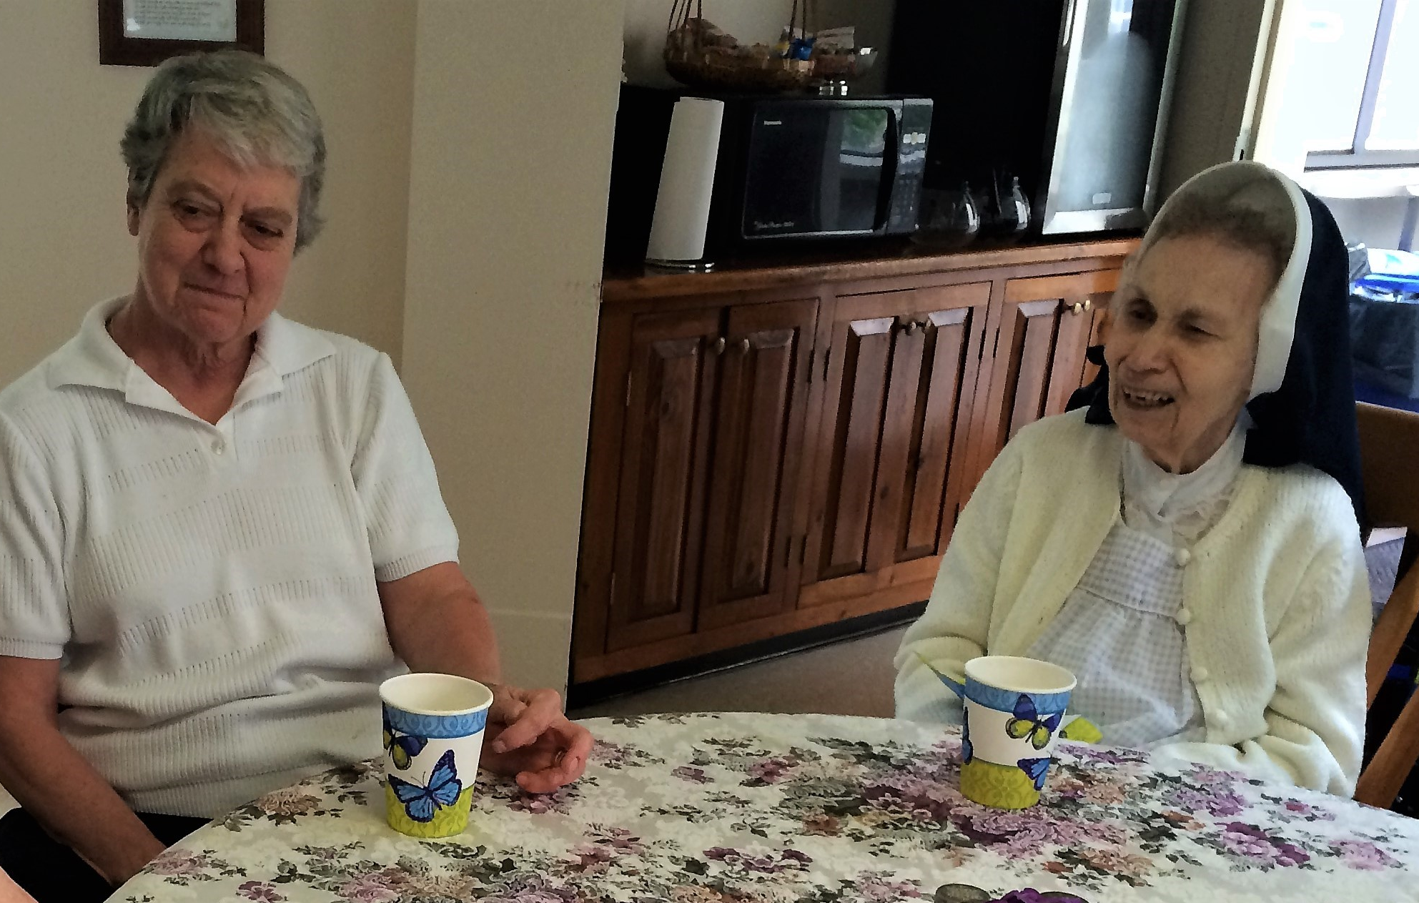

Slide 9
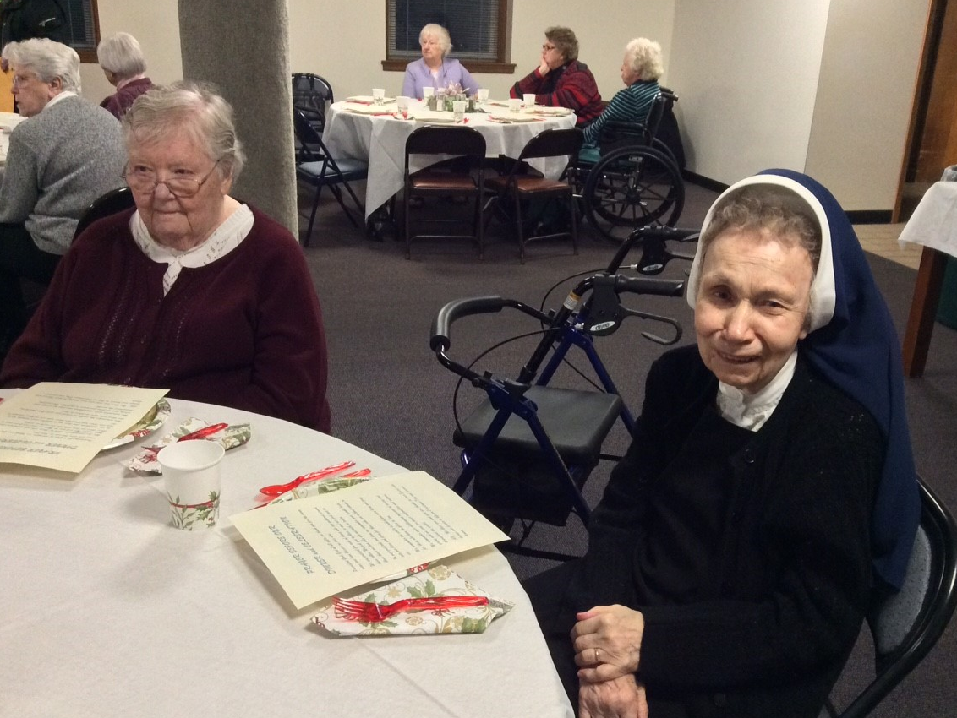

Slide 10
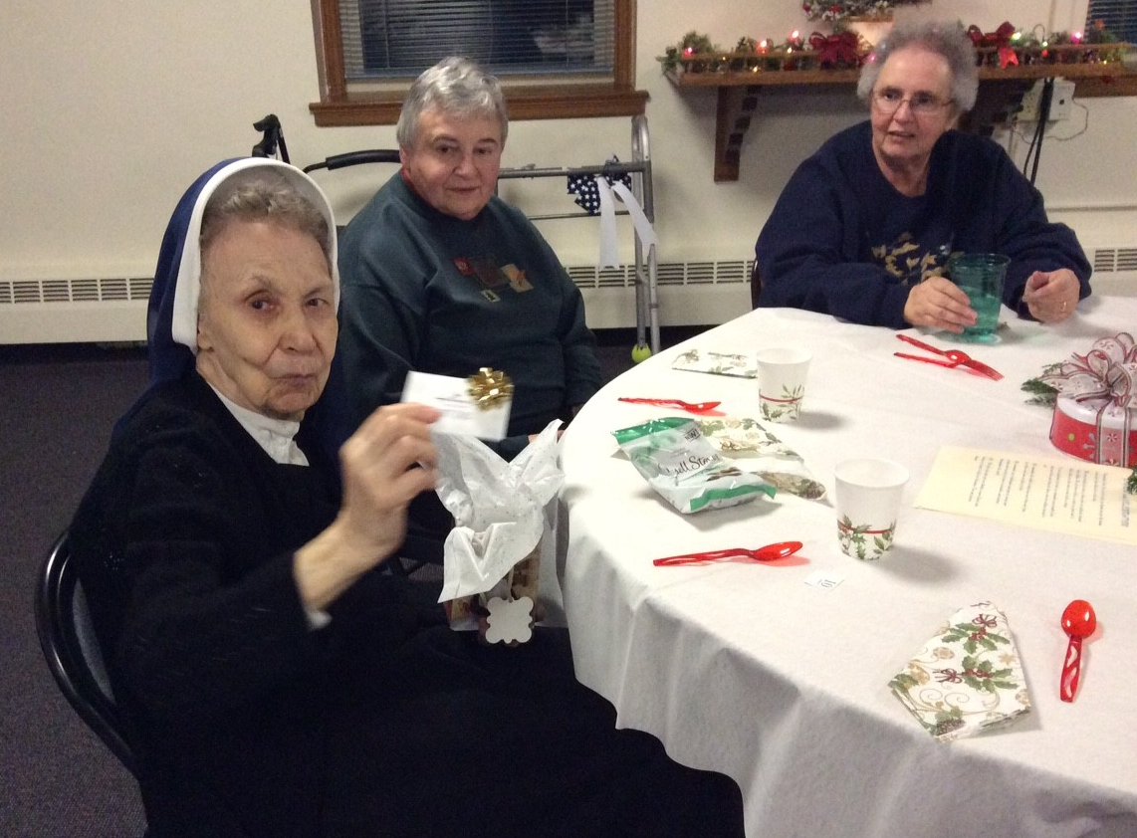

Slide 11
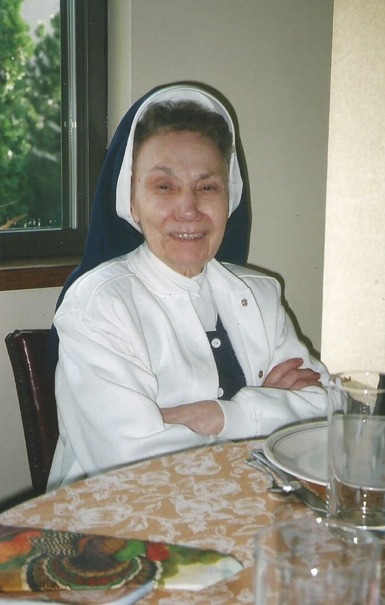
“You will be missed by so many that you have touched with your kindness!”
Dotty Parker Higgins

Slide 12
“Wonderful woman kind
loving
and
spiritual.”
Evelyn Raeke

Slide 13
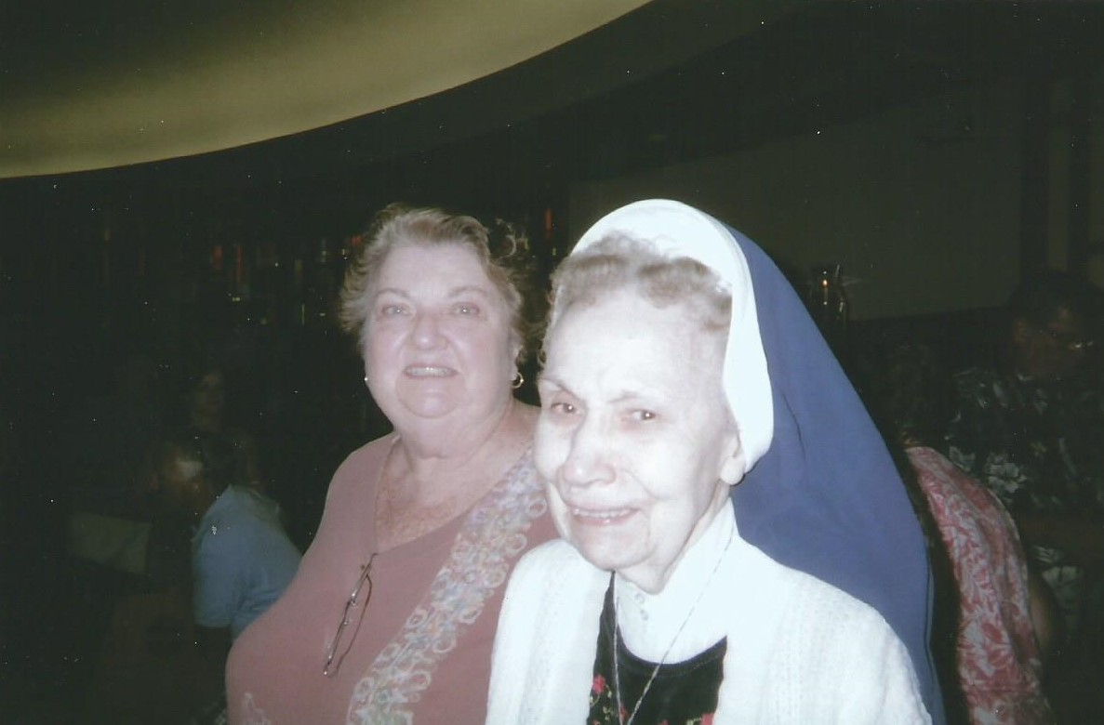

Slide 14
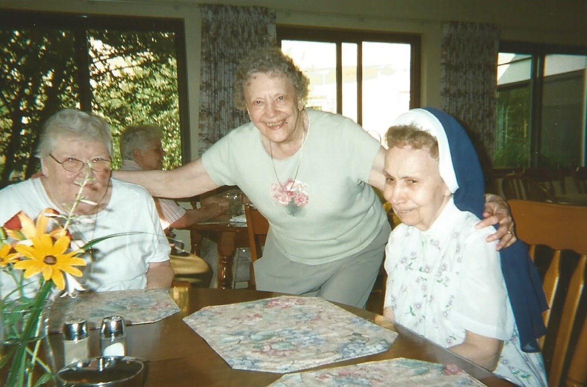
Enjoying the company of her classmates:
Sisters Danella and Anna Marie

Slide 15
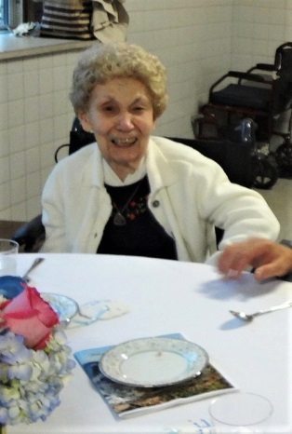
“She was a gentle lady
who touched the lives
of
many people.”
Rita Gillis Guinta

Slide 16
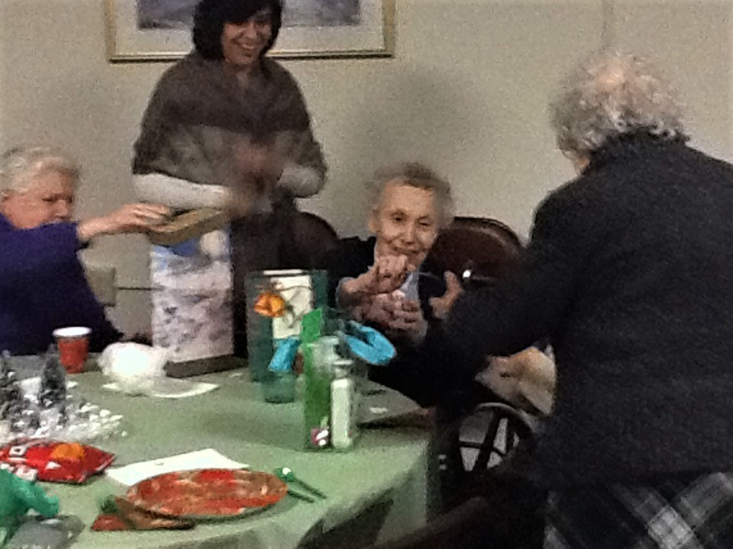

Slide 17
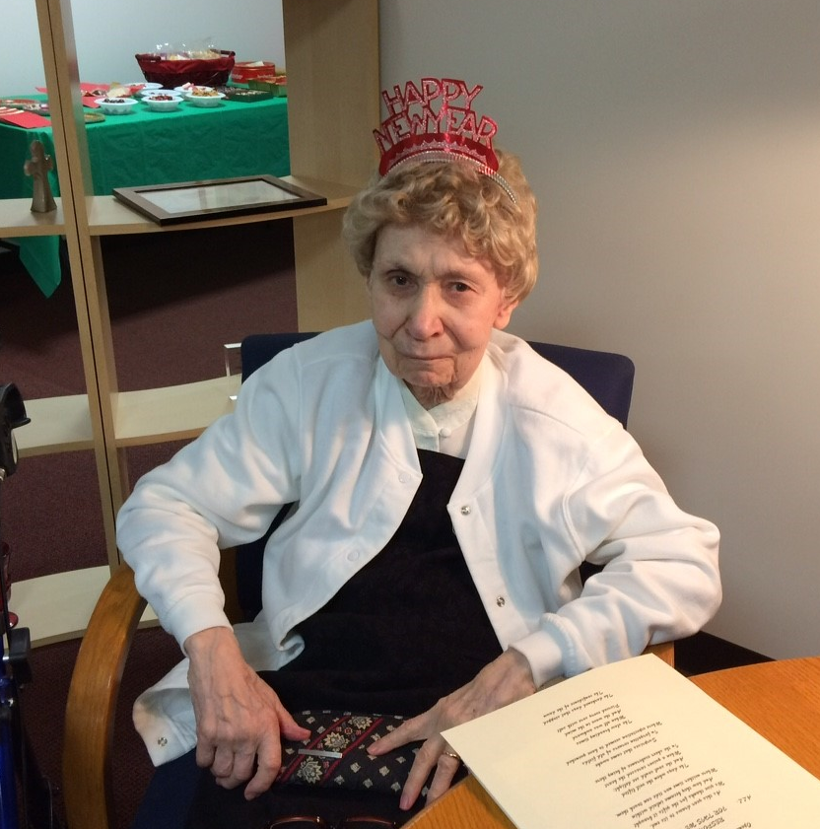
“Always there when I needed her!
May she live in God’s loving presence!
Bernadette Duman, CDP

Slide 18
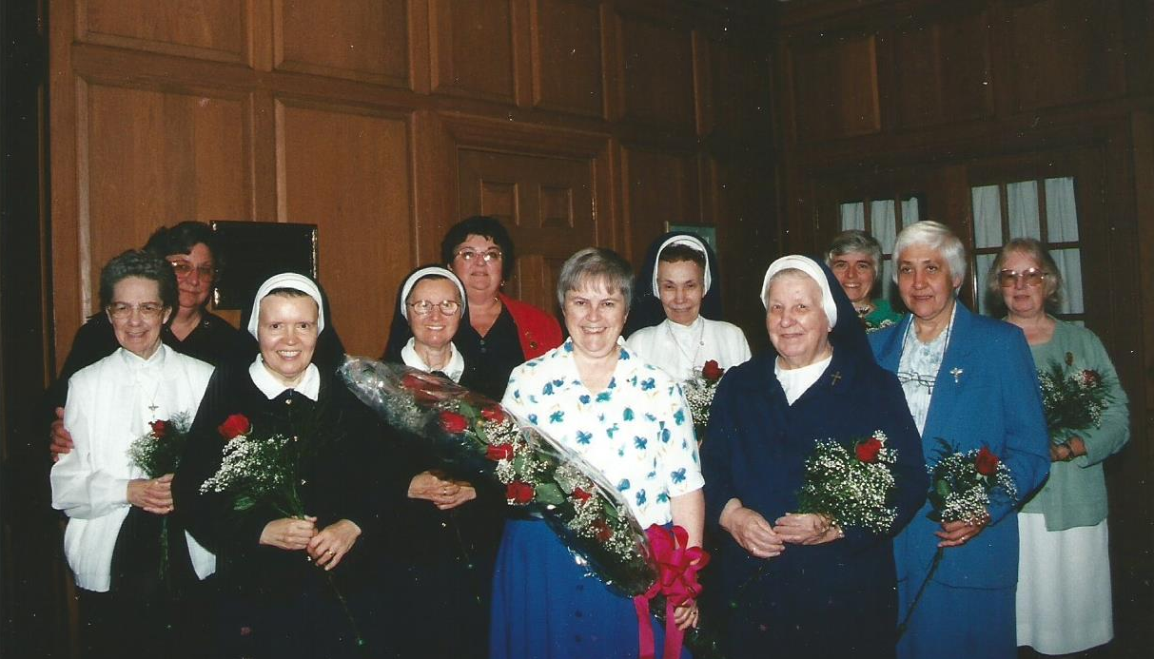
Honoring Sisters who ministered at Sacred Heart

Slide 19
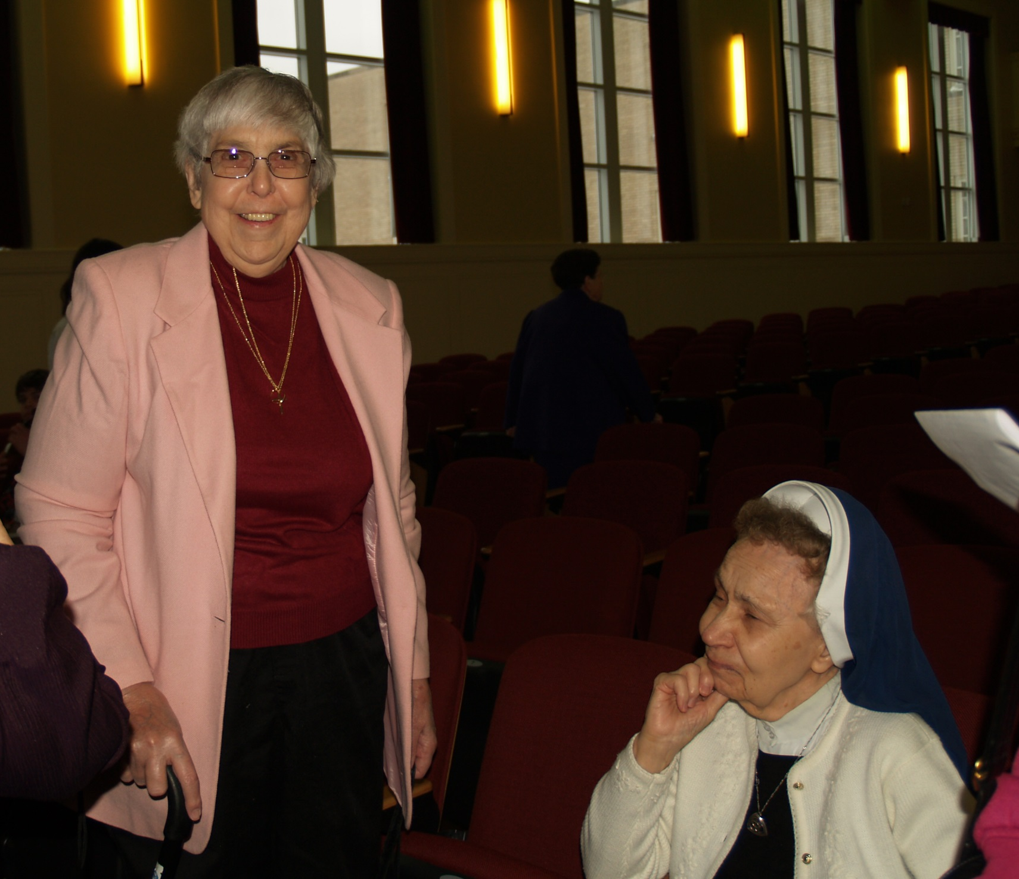

Slide 20
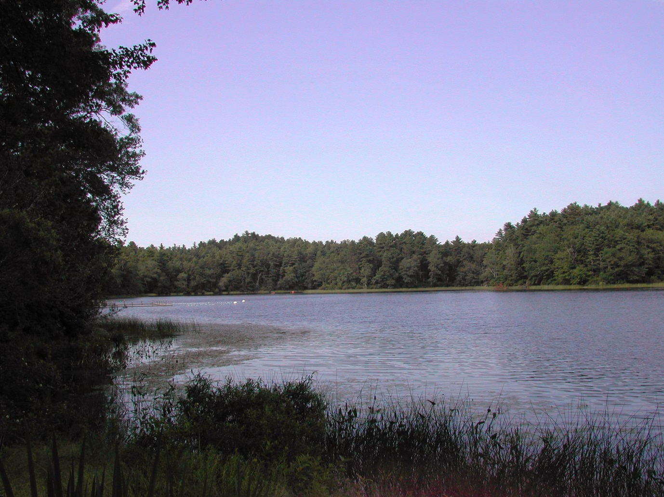
Summer Ministry
at
Camp Mishannock

Slide 21
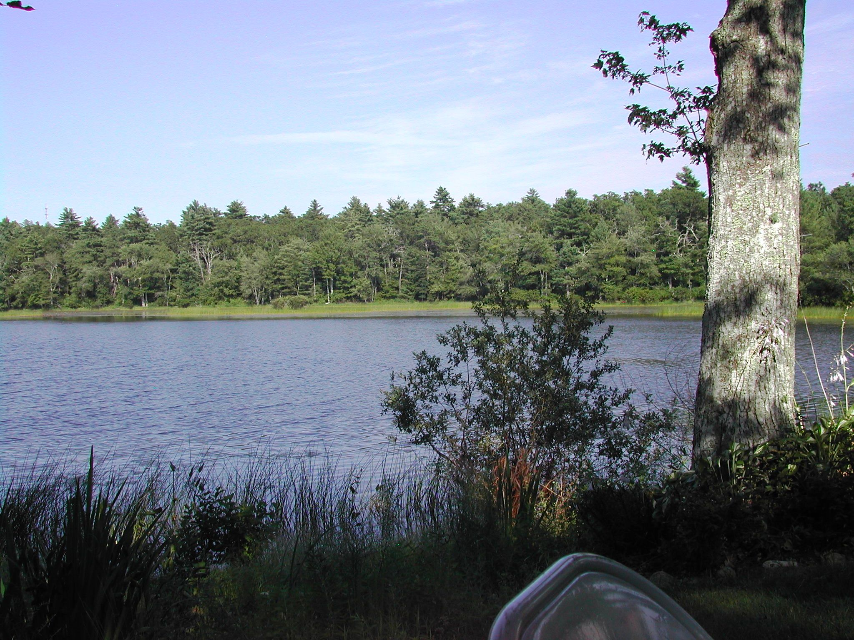

Slide 22
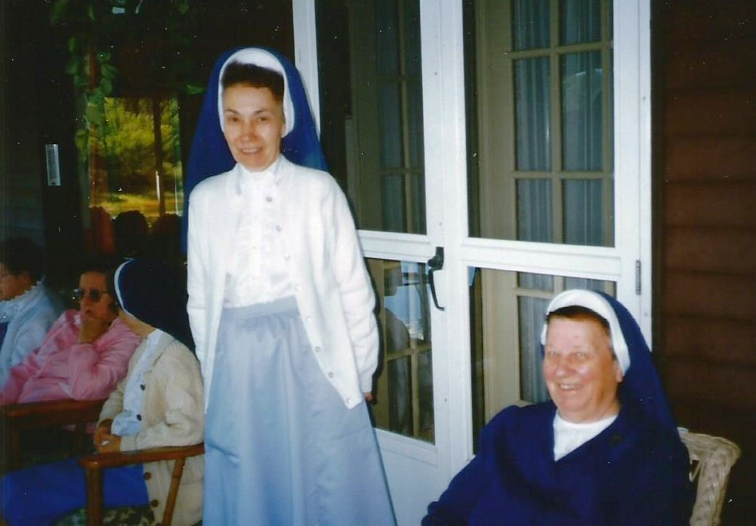
Memories ~

Slide 23
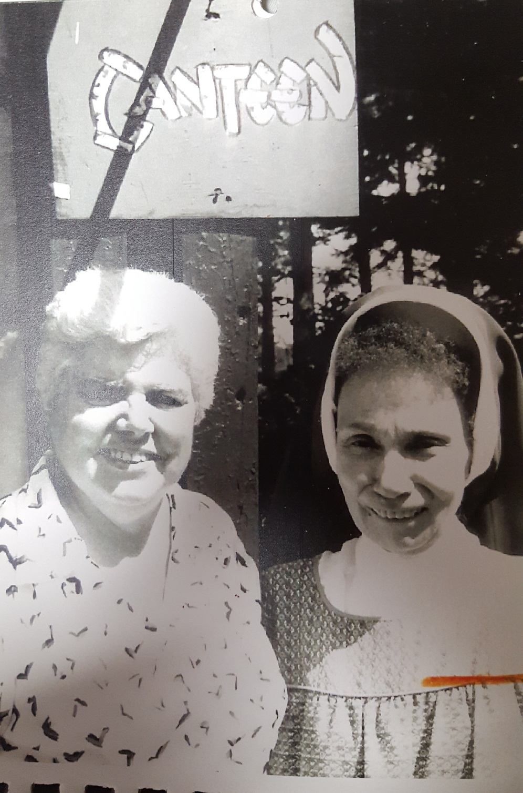
Sister John Francis
with
Sister Lorraine

Slide 24
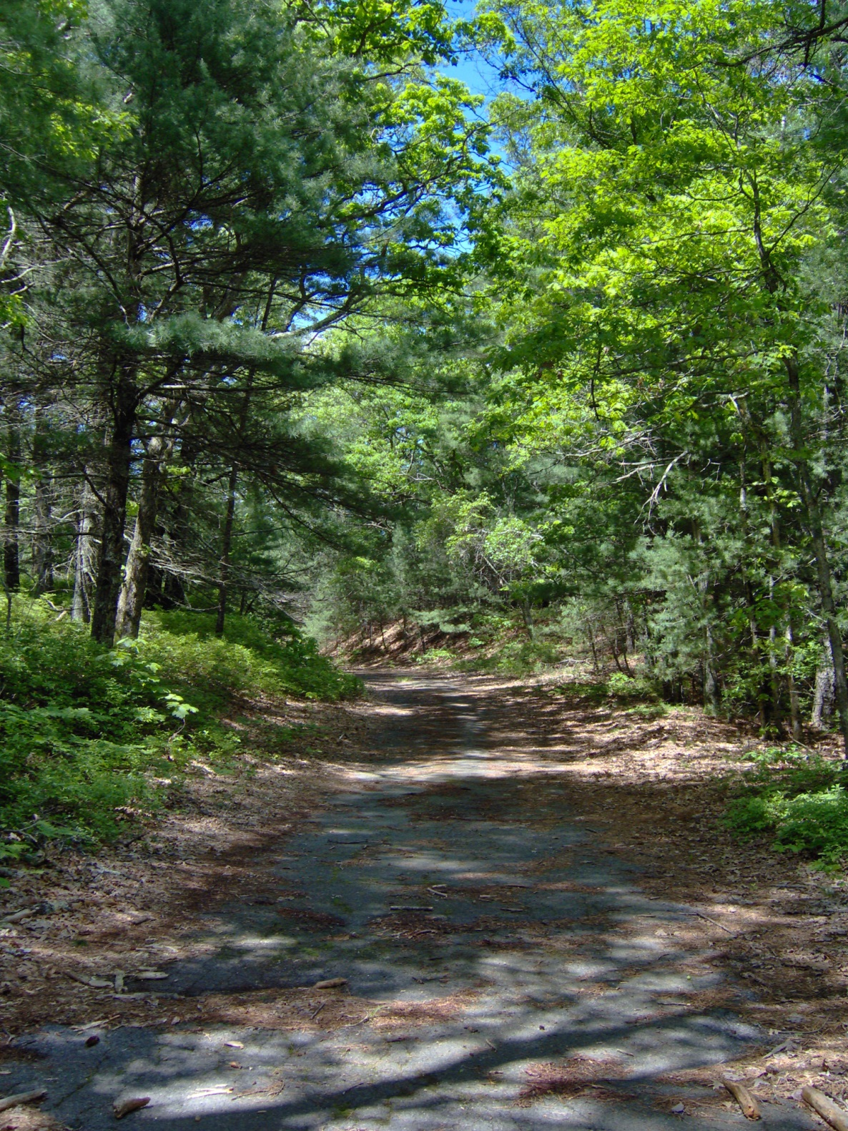
Summer
Home ~

Slide 26
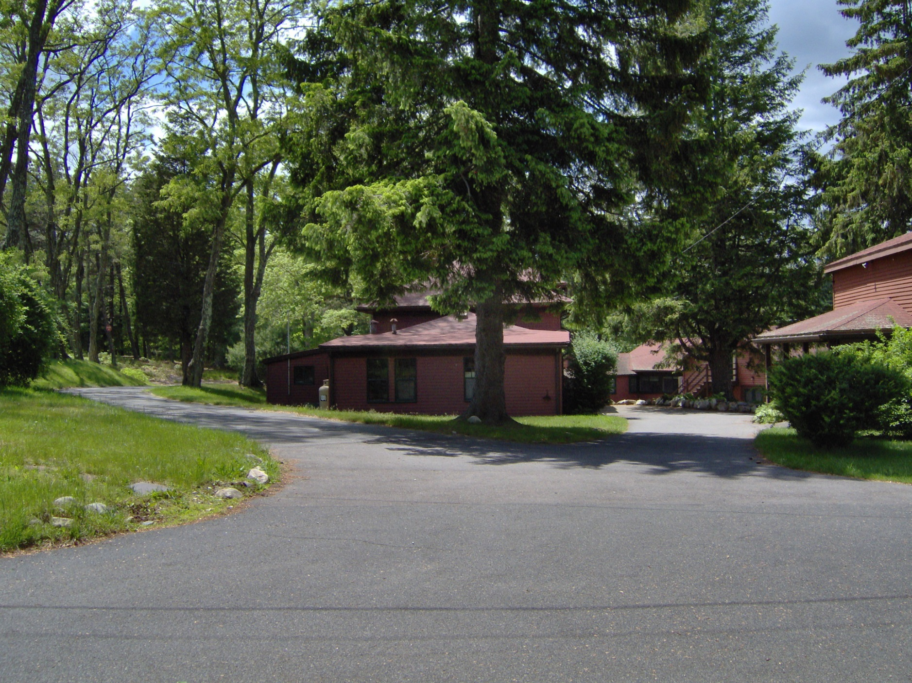
Familiar Places ~

Slide 27
Jubilee
Celebrations

Slide 28
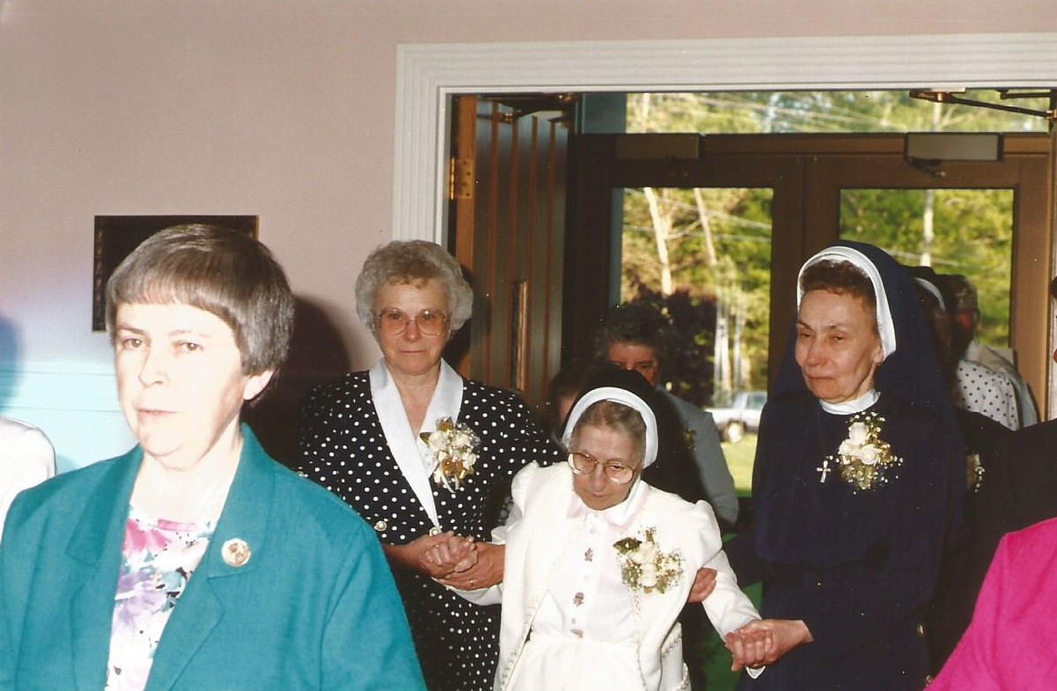
Golden Jubilee ~ 1994

Slide 30
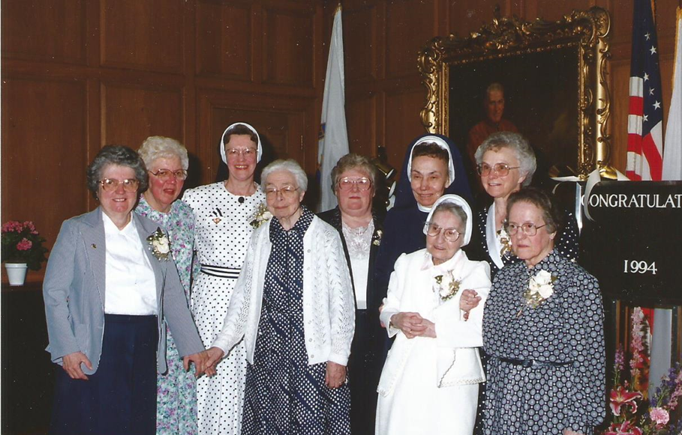

Slide 31
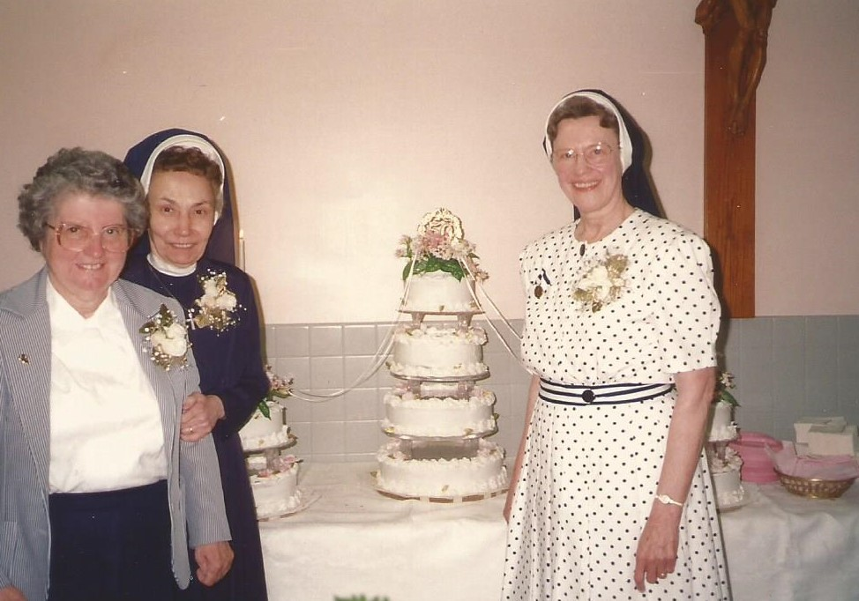

Slide 32
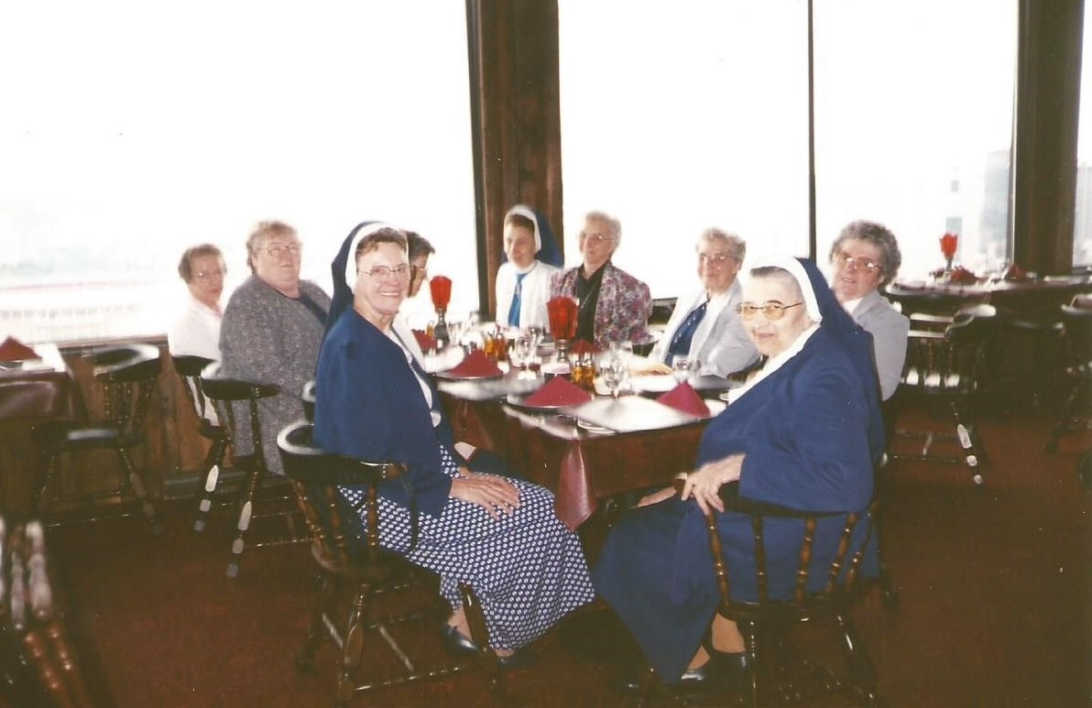
Celebrating with her Classmates

Slide 33
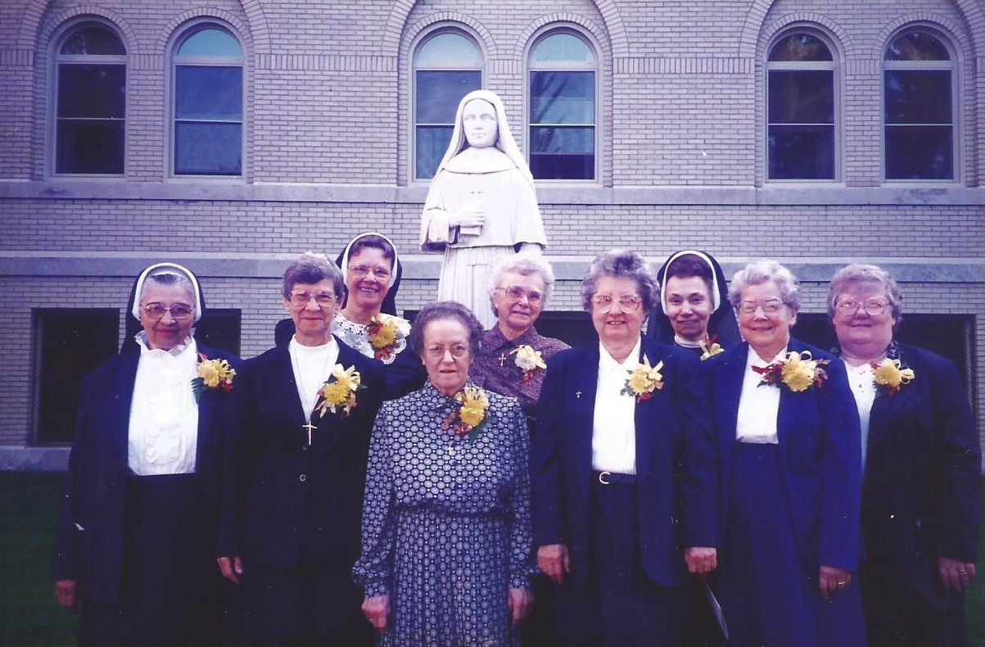
Golden Jubilee Celebration
with classmates in Pittsburgh PA

Slide 34
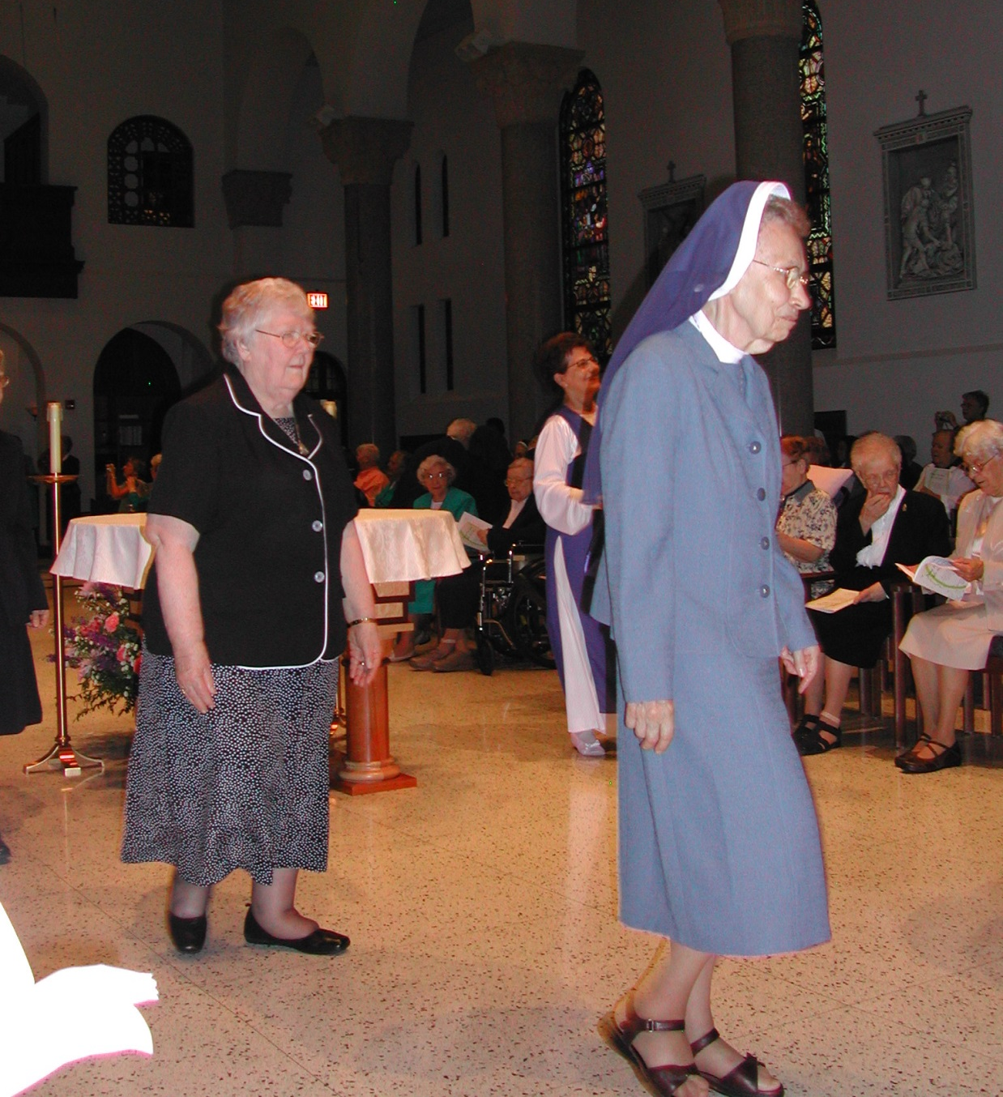
65th
Jubilee Celebration
at
Providence Heights

Slide 35
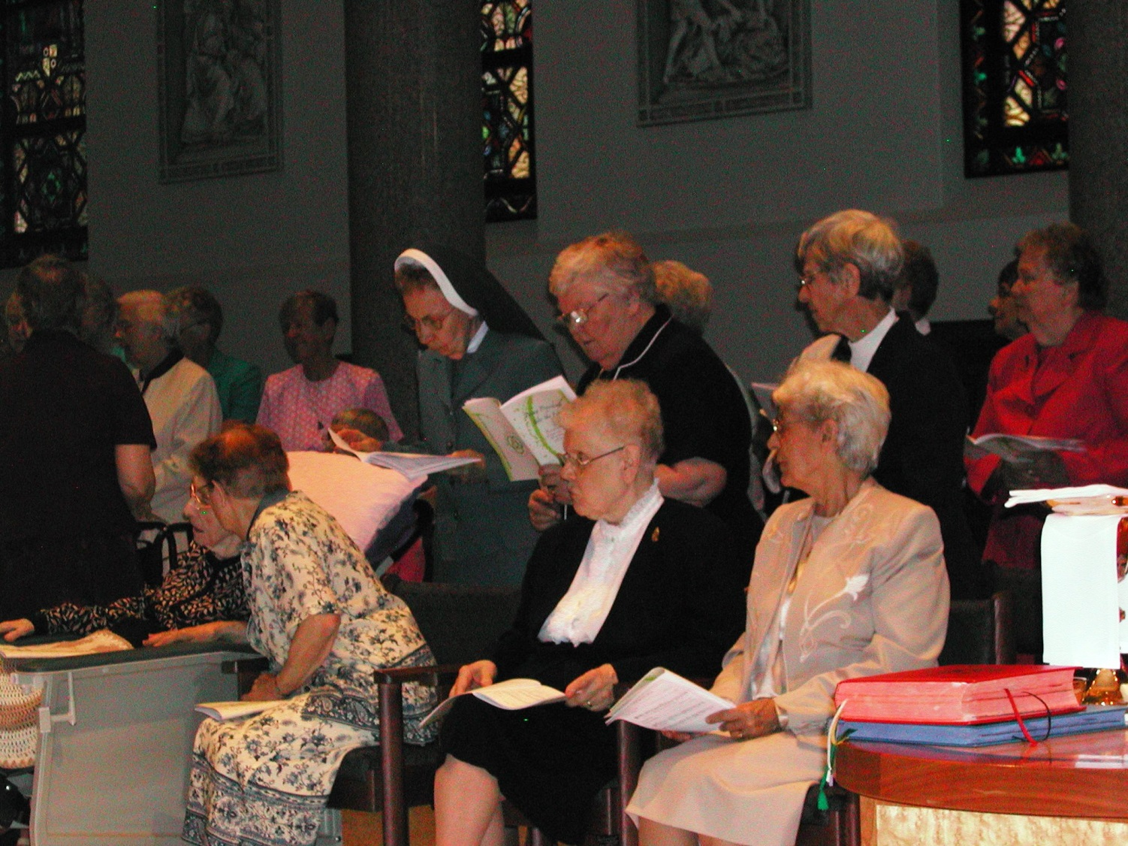

Slide 36
“May her memory be eternal.”
Pamela Egan Walsh

Slide 37
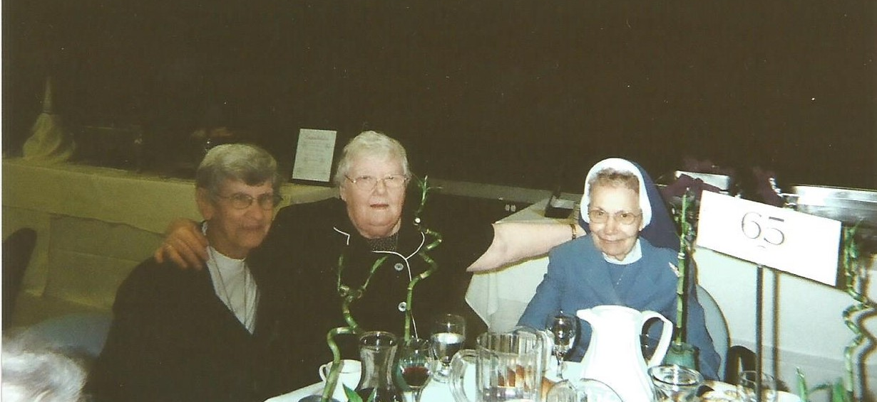
Celebrating with Classmates ~

Slide 38
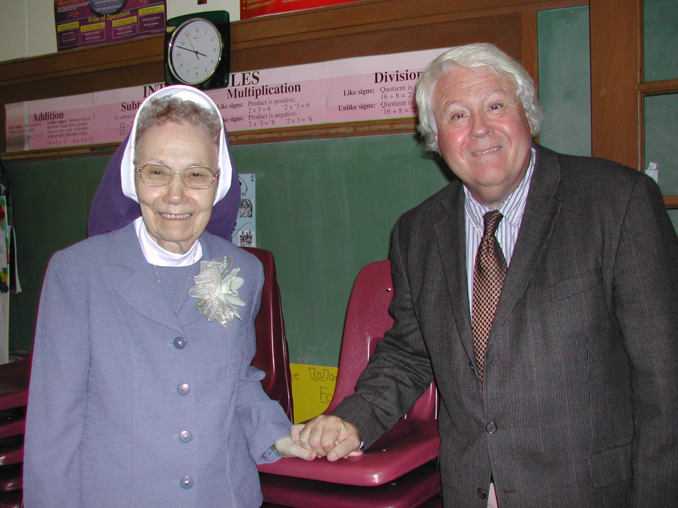
Diamond Jubilee ~ 70th

Slide 39
Spreading the Mission
Ever the Educator
“One of the pioneer Sisters in the ministry of education at
Sacred Heart School in
Kingston, MA”

Slide 40
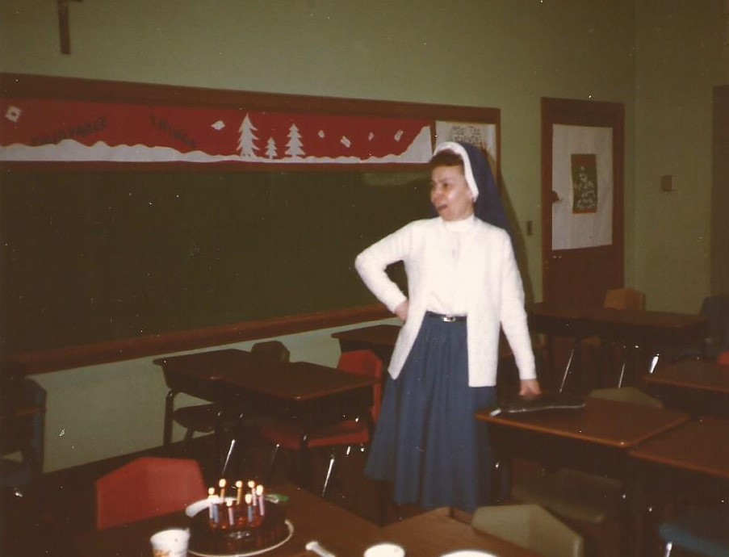
“Sister John Francis is a class act,
living a very saintly life. … we have lost a saintly friend.”
George Rose

Slide 41
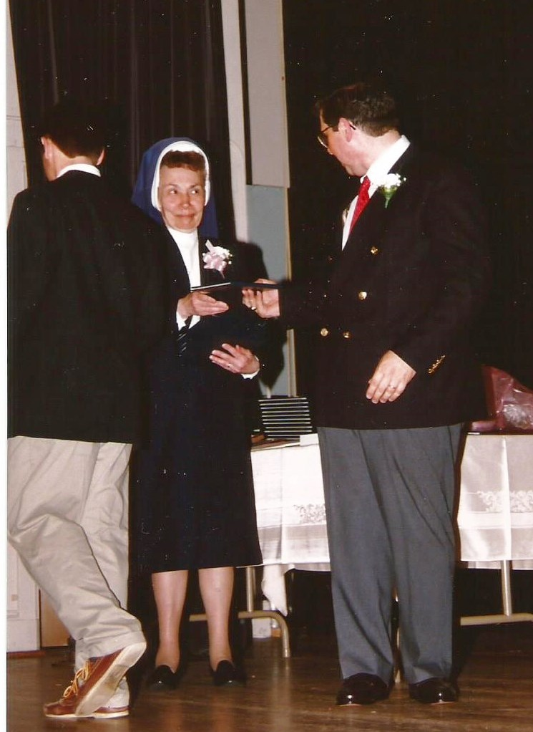
Junior High Graduation
with
John Enos

Slide 42
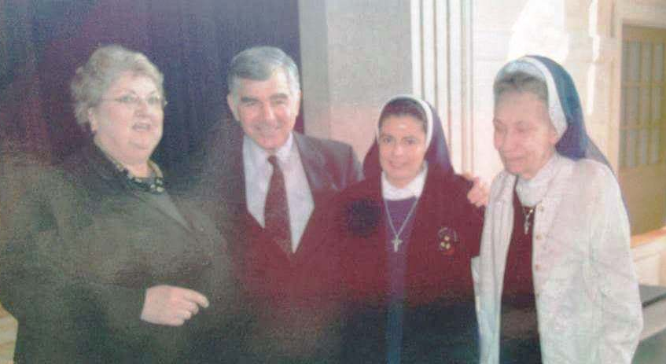
“She was a gentle and caring woman, my Mentor teacher
at Sacred Heart High School.
Que en Paz Descanse.”
Nélida Naveros Cordova, CDP

Slide 43
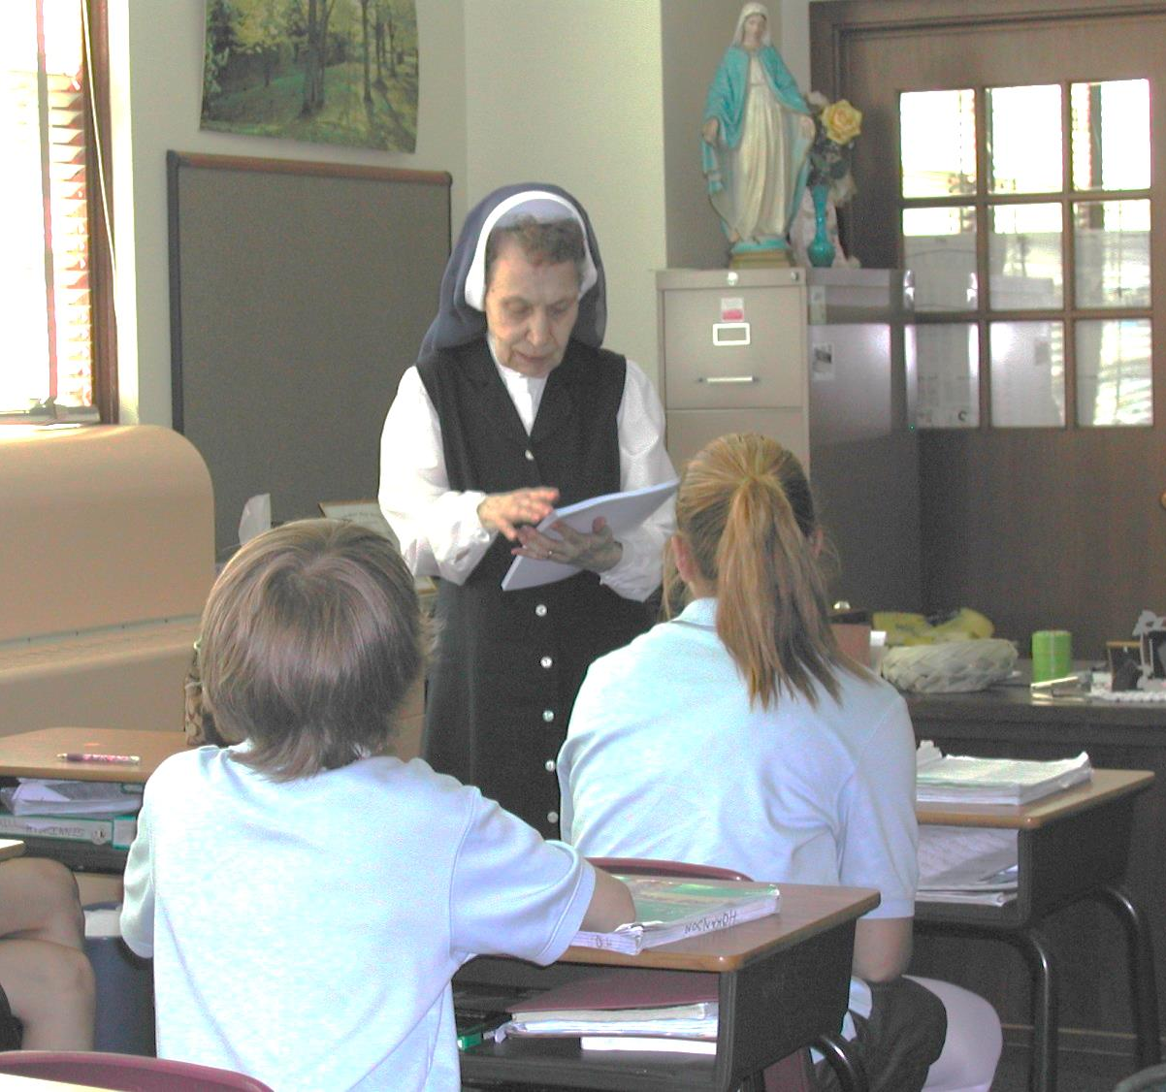
“She used her life
to touch
so many other lives.
Truly a rare spirit.”
Anna Dukess

Slide 44
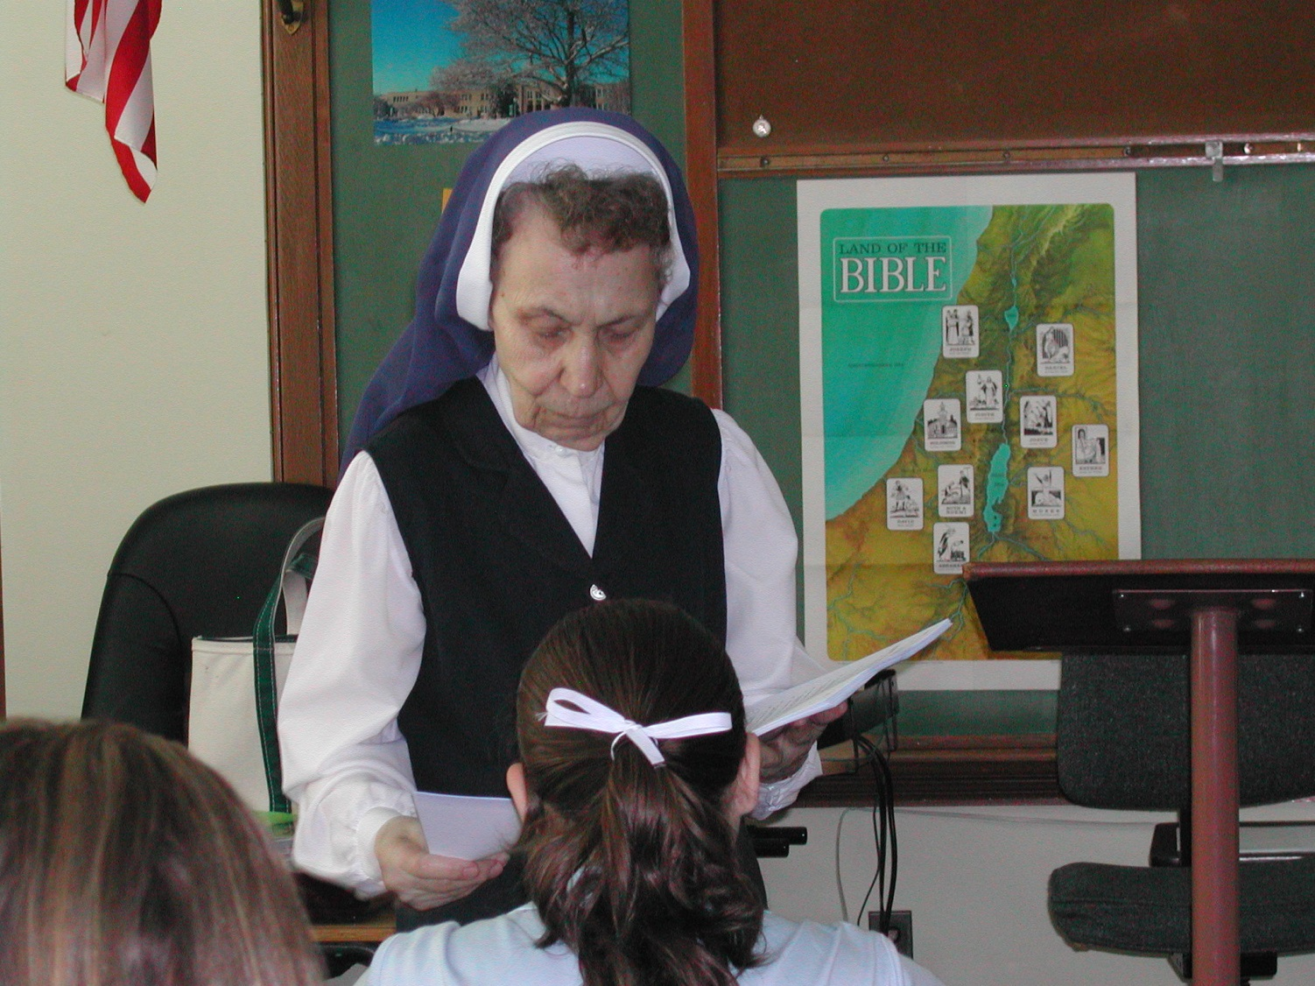
“I loved her as my teacher. She was great.”
Colleen Woods

Slide 45
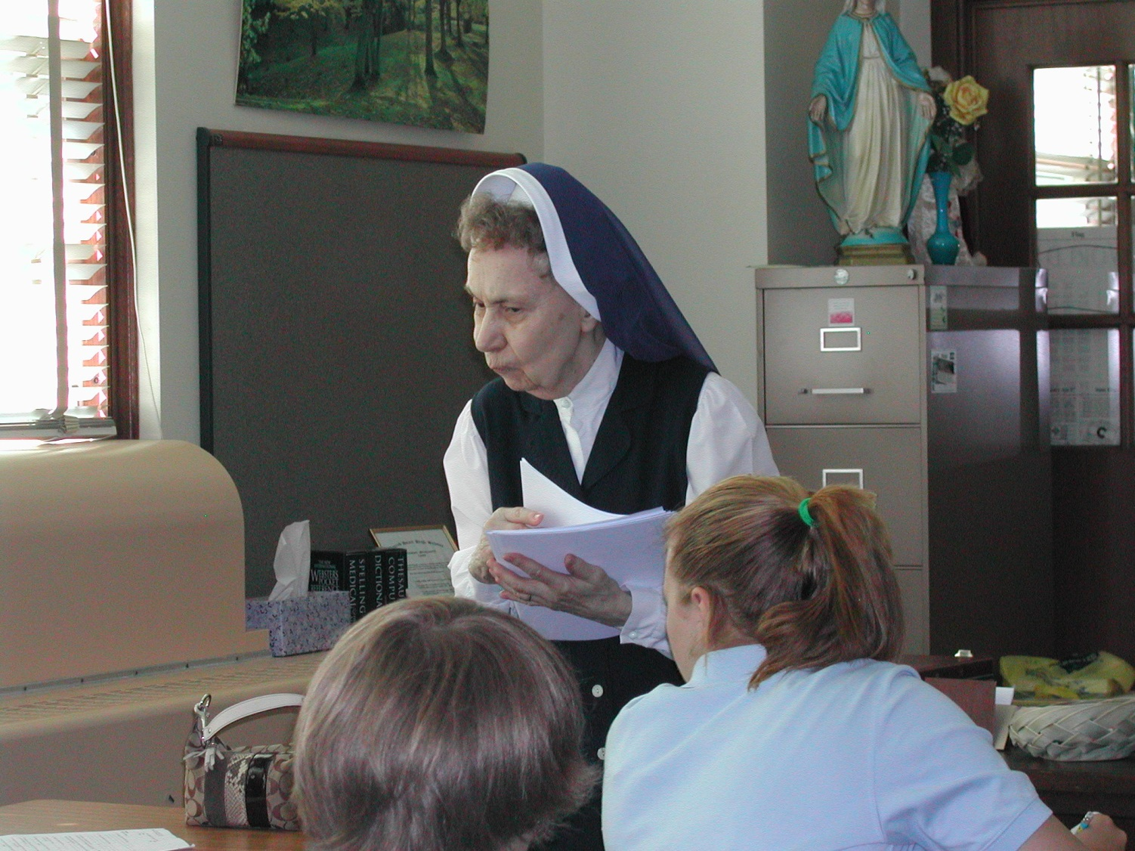
“A truly special
and
kind woman who will
be missed but not forgotten.”
Douglas Trudeau

Slide 46
“The kindest soul I've ever had the pleasure of meeting.
She is such a testament to living the Golden Rule.
I am happy that she is at last home with our Lord
and
grateful for the honor of knowing her.”
Kerry Winterson

Slide 47
“I remember seeing her on Friday afternoons, after everyone had left, spending a lot of time cleaning and vacuuming her classroom. Always taking pride in our school and keeping her classroom clean for her students (even at her advanced age)- that always struck me as such a mark of dedication. Truly a life of service and an example to all of her students just like so many of our teachers at SHHS.”
Joe Sheehan

Slide 48
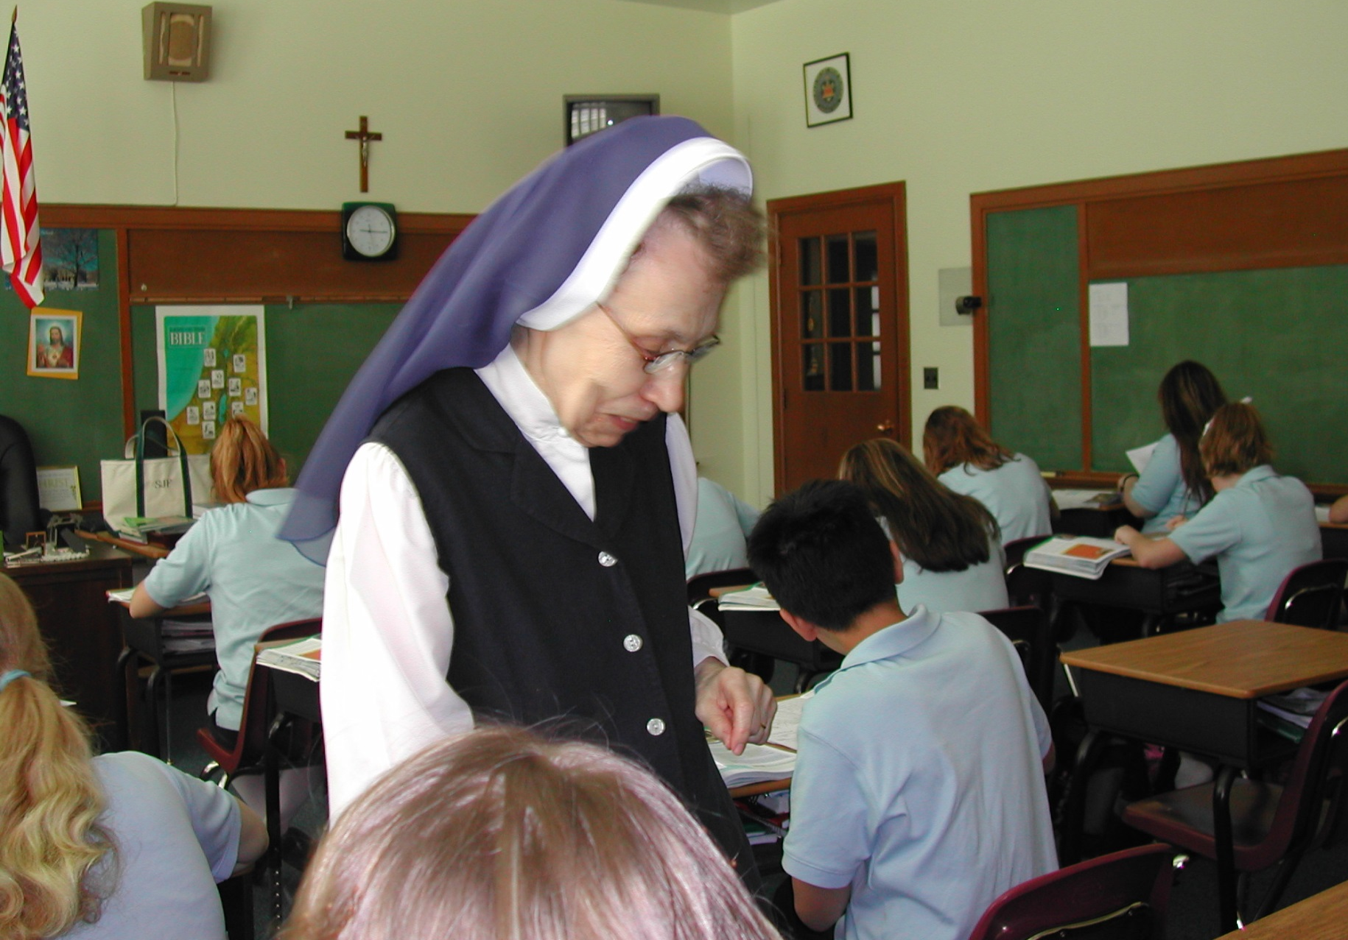
“Was truly one of the best.”
Cheryl Catton

Slide 49
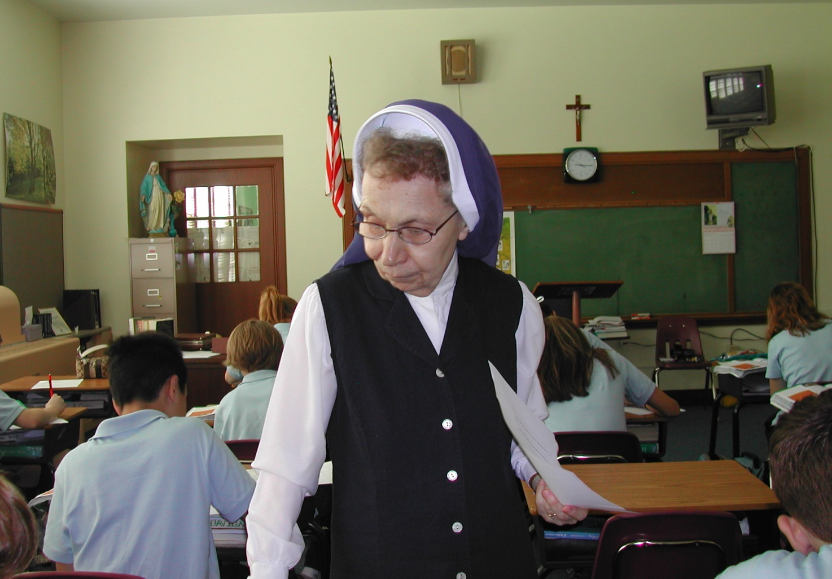
“…she was one of my favorites.”
Heather Kasey
“She will be missed.”
Dayton Kinney

Slide 50
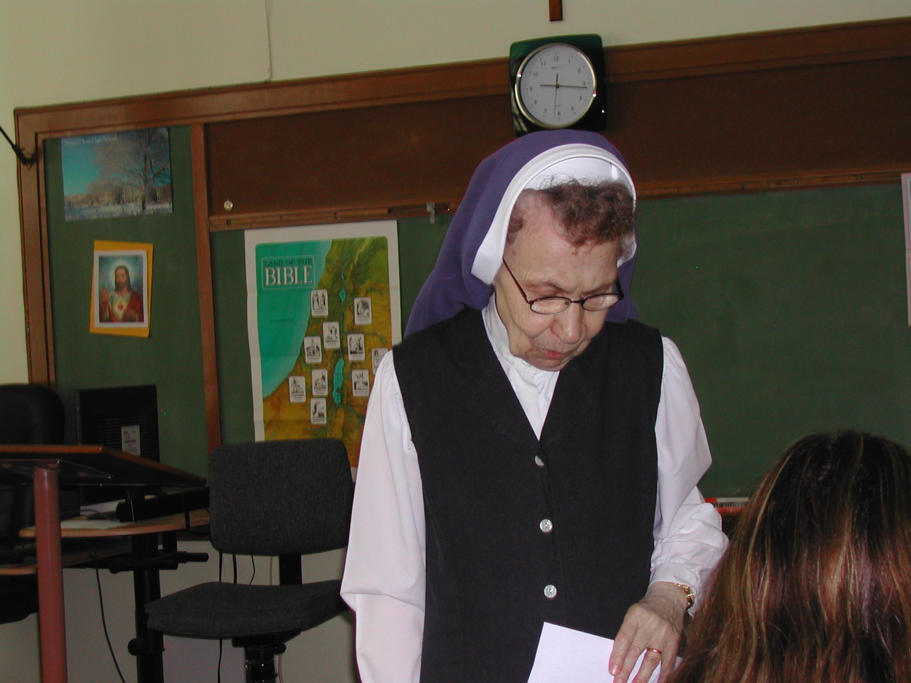
“…she was a great person and one of my favorite teachers.”
Gina Sacchetti

Slide 51
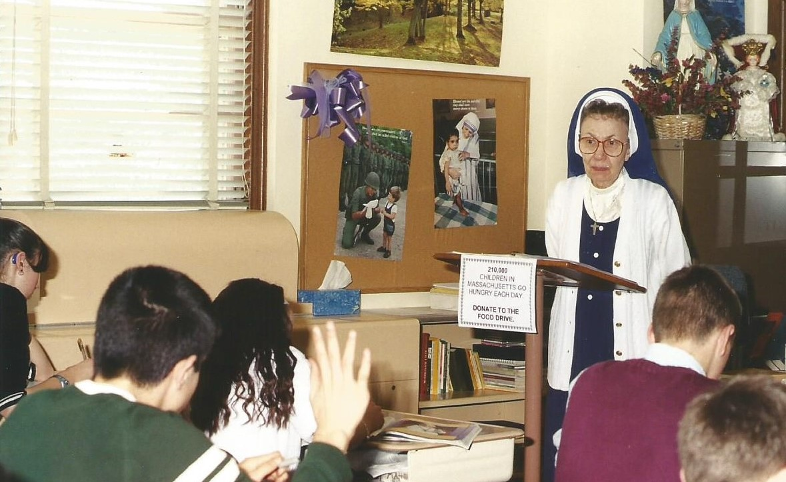
“She was a gentle lady who touched the lives of many people.”
Rita Gillis Guinta

Slide 52
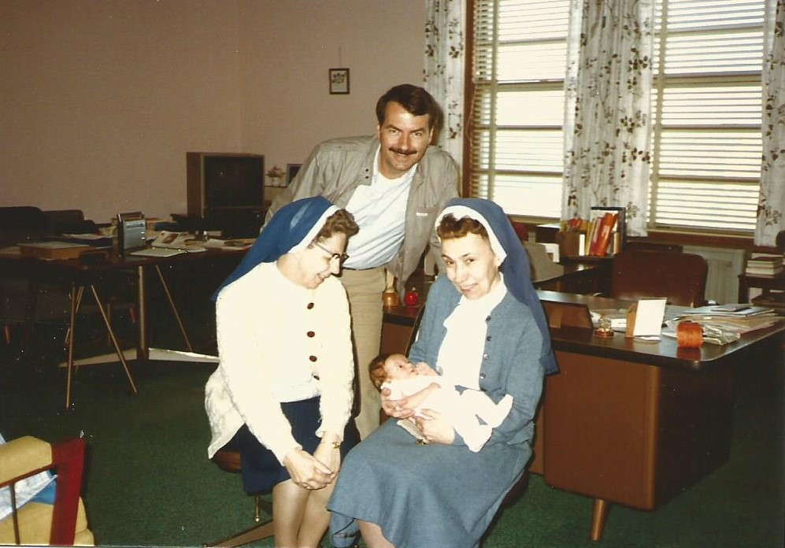
Former student,
Kevin MacNamara
returns to visit!

Slide 53
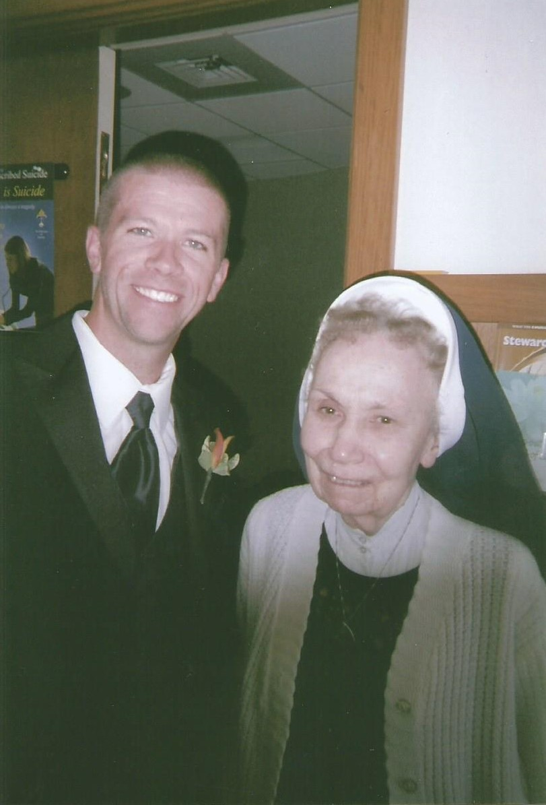
Former Student
Michael League
with Sister

Slide 54
“She was such a big part of our lives.
She was the sweetest soul.
All she had to do to keep us in line was a look
and a
"say, say, say".
We loved her.”
Joy Murphy

Slide 55
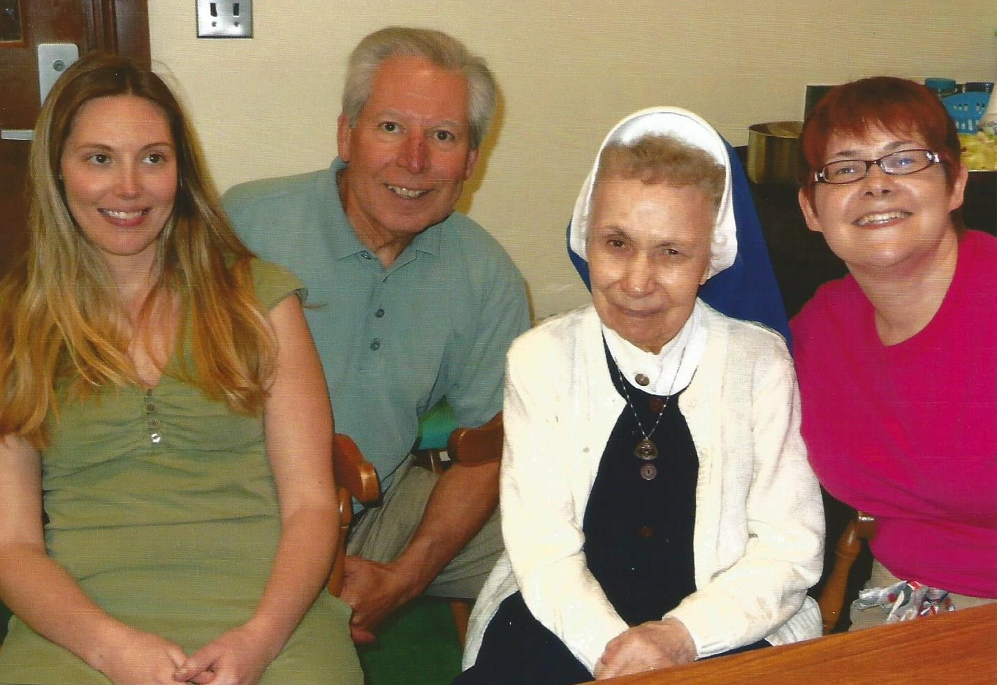
Former Colleagues

Slide 56
MASSACHUSETTS FORENSIC LEAGUE
HALL OF FAME INDUCTEE
Sister John Francis Danko
Your contribution has been a great
example for all to see and admire.
You have set the standard
for excellence in speech.
April 28, 2001

Slide 57
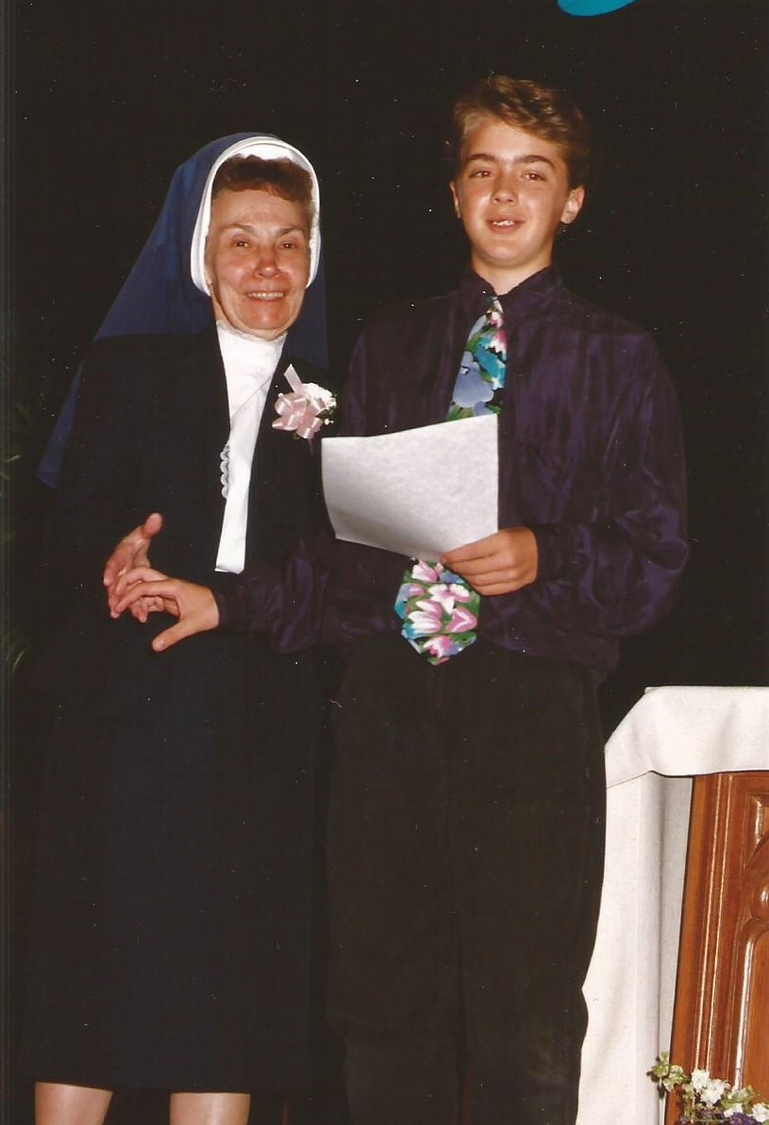
Youth Speaks
Forensics:Speech and Debate
Student

Slide 58
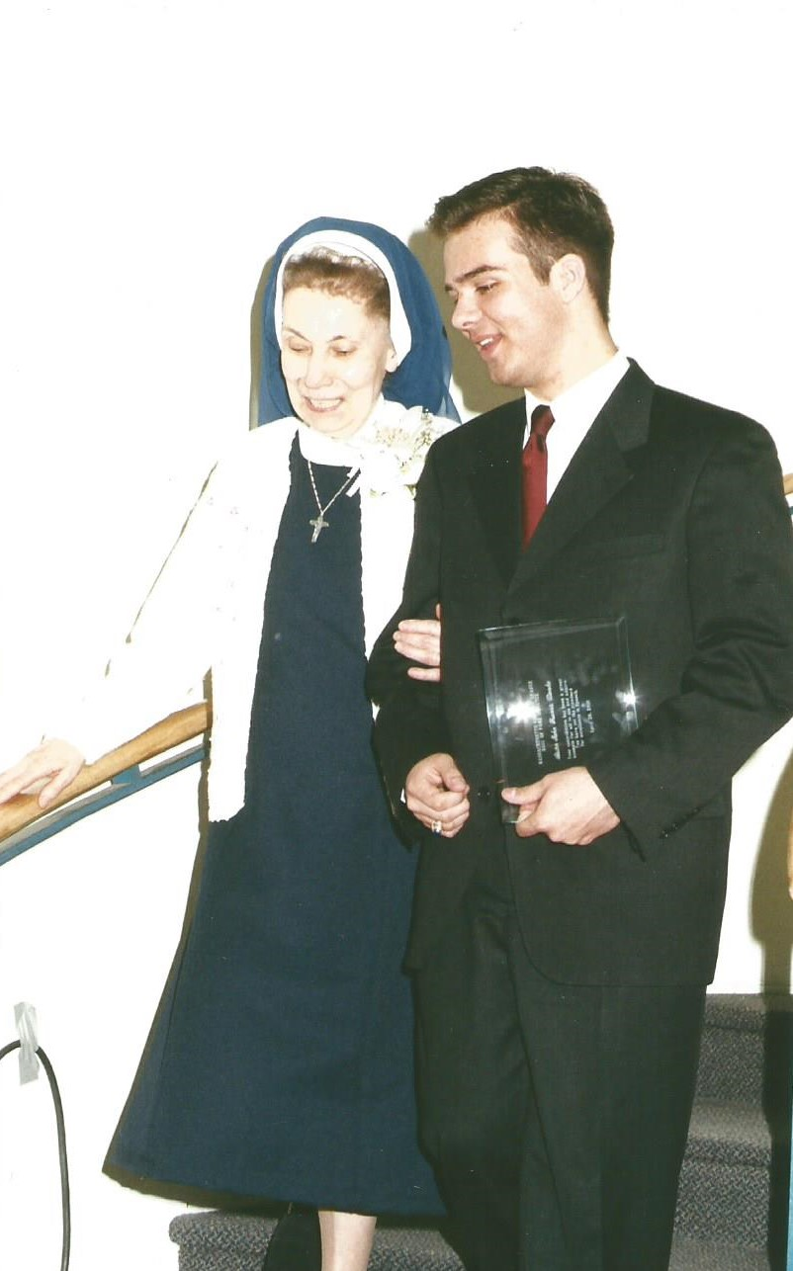
Forensics:
Speech and Debate
Youth Speaks
Keith Barry
with Sister

Slide 59
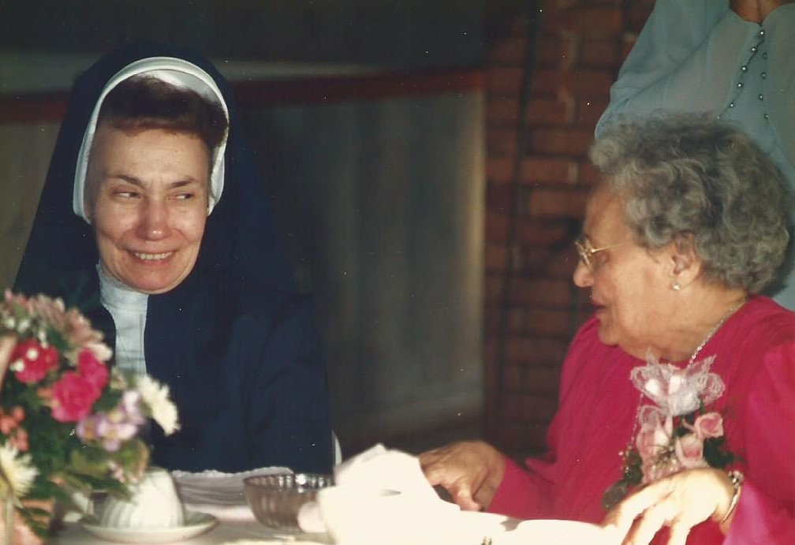
“Wonderful woman,
God bless her.”
Donnamarie Gambino Bentley

